Slide 1
Women in the Bible: Anna and me
Insight comes with age
“Your word is lamp for my feet and a light for my path.”
Psalm 119:105
12
LESSON

Slide 2
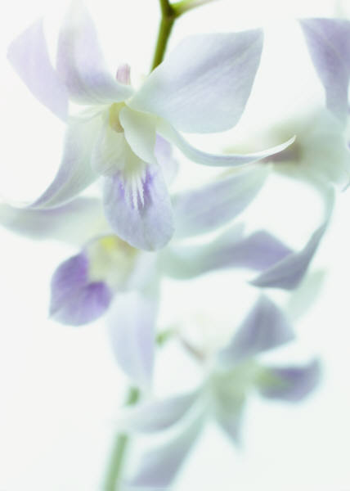
Anna
Her Name Means “Favor” or “Grace”
Key Scripture: Luke 1 and 2
Introduction
Anna of Jerusalem was a prophetess. There had been a few others before her—godly- inspired women whose deeds were well known and whose very words were remembered.

Slide 3
Anna
Her Name Means “Favor” or “Grace”
Anna was known to be remarkably devout, habitual and earnest in prayer, and having the gift of prophetic utterances. Married for only seven years, she spent the long years of her widowhood fasting and praying in the temple, abandoning herself entirely to God. A prophetess, she was one of the first to bear witness to Jesus.
If you long to see your Savior, to experience His presence in your life, Anna’s devotion will encourage you.

Slide 4
Anna
Her Name Means “Favor” or “Grace”
Discover
* Her Age
* Her Devotion
* Her Missionary Work

Slide 5
Anna
Her Name Means “Favor” or “Grace”
Going Deeper
What was Anna’s profession? (Verse 36)
2. How old was Anna at this time? (Verses 36-37)
3. What was her marital status? (Verse 37)

Slide 6
Anna
Her Name Means “Favor” or “Grace”
4. How did she spend her time? (Verse 36)
Note: In spite of the loss of her husband, Anna remained true to God. She was among the faithful women who daily worshiped at the temple and took part in the religious services. Earlier in the chapter, in verses 22 through 35, we read about Mary and Joseph bringing the Baby Jesus to the temple to present Him to the Lord. The prophet Simeon recognized Jesus as the Savior, and blessed the family. He also gave some insight into what the life of Jesus would be like on this earth.

Slide 7
Anna
Her Name Means “Favor” or “Grace”
5. After Simeon had blessed Mary, Joseph, and the Baby Jesus, who came on the scene? (Verse 36)
6. The Bible tells us that Anna gave thanks unto the Lord and then went on to do what? (Verse 38)

Slide 8
Anna
Her Name Means “Favor” or “Grace”
Words for Today
7. When you read the last part of verse 38, how do you think Anna went about talking about Jesus?
8. Should we also follow the example of Anna, and with prayer and fasting, prepare to tell the story of the “Blessed Hope”? Explain.

Slide 9
Anna
Her Name Means “Favor” or “Grace”
Questions for Discussion
As you study the book of Luke, notice the many women mentioned. Why do you think women figure so prominently in Luke’s gospel?
2. Compare the reactions of Simeon and Anna to the realization of their hopes.

Slide 10
Anna
Her Name Means “Favor” or “Grace”
Words of Wisdom
With age comes insight into matters that we may not have understood when we were younger. Our ability to understand a situation grows as we study God’s Word and pray for His blessing upon our study. Fasting and prayer are somewhat out of fashion today; however, there is much to be gained from practicing these two disciplines. God blesses those who long for a closer walk with Him. He desires us to do as Anna did, to be faithful in attending worship services, studying, and communing with Him daily.

Slide 11
Anna
Her Name Means “Favor” or “Grace”
My Prayer for Today
Dear Heavenly Father, today I desire to follow your will and to be a faithful witness of your love. Be with me as I rededicate my life to you and choose to spend more time communing with you.

Slide 12
Anna
Her Name Means “Favor” or “Grace”
Sharing
Be prepared to give your testimony as to what a difference having Jesus in your life
has made. Tell His story in such a kind and thoughtful manner that others will be drawn to Him. Remember that witnessing of Christ and His love does not always mean preaching or using words; sometimes it is best shown by lending a helping hand, giving a hug, or sharing a loaf of bread with those who need to see the love of Christ in action.

