Slide 1
Are You Thirsty for Living Water?
by Galina Stele, D.min.
General Conference
2016 Women’s Ministries Emphasis Day
Notes:
Sermon
Are You Thirsty for Living Water?
By Galina Stele, D.Min.

Slide 2
If anybody is thirsty, let him come to me and drink. John 7:37
Notes:
“If anybody is thirsty, let him come to me and drink” (John 7:37).

Slide 3
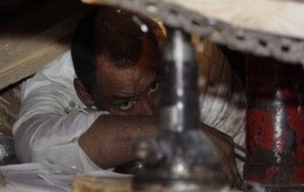
2010 Haitian earthquake survivor
Evans Monsignac is
The longest-ever earthquake survivor
The longest without-water survivor
Notes:
Do you know how long people can live without food or water? Some say people can live 40 days without food but only 3 or 4 days without water. If one survives longer without water, it is considered a miracle. One such miracle was a Haiti earthquake survivor, Evans Monsignac. He was 27 years of age when the terrible earthquake struck Haiti in January 2010. A father of two children, and a struggling rice seller in a poor Haitian market, he left for his job as usual on that day. Everything seemed normal until he saw buildings in the market start to collapse. The walls fell on his right and left, preventing his escape. People were screaming around him, and everything was terrifying, especially when a piece of concrete fell toward his face. Then something unexplainable happened; he felt like someone came in and pulled the piece back. Evans was trapped in darkness. He was able to breathe but was afraid to move and perhaps injure himself or cause further movement of the cement. During the first day, he heard people screaming, but gradually the cries died out and it became eerily silent.

Slide 4
2010 Haitian earthquake survivor
Statistics:
27 years old
27 days trapped
Without food
Without water
27 kilograms of weight lost (60 lbs) When discovered, he weighed only 88 lbs (40 kilograms)
Notes:
When he was finally pulled from the devastation, the rescue team reckoned he had been trapped there for 27 days without food or water, although he did not know how long he had been there. He lost the perception of time, falling into unconsciousness from time to time. He lost 60 pounds (27 kilograms) and was only 88 pounds (40 kilograms), when he was rescued and eventually brought to Tampa General Hospital in Florida. He was the longest-ever earthquake and without-water survivor. People thought that he probably had access to water or some food during the time of his terrible imprisonment. “No,” he said. But he had the access to sewage water that he noticed on his second or third day. He tried to taste it, but it made him sick in his stomach, so he dipped his little finger in it and wet his lips and tried to swallow it. It was very disgusting and made him sicker as time went on. Did this help him to survive? It is hard to say.

Slide 5
I was resigned to death, but God gave me life.
Evans Monsignac
Notes:
He himself gave credit to God for his survival when he was telling his story. “I was resigned to death,” he said, “but God gave me life.

Slide 6
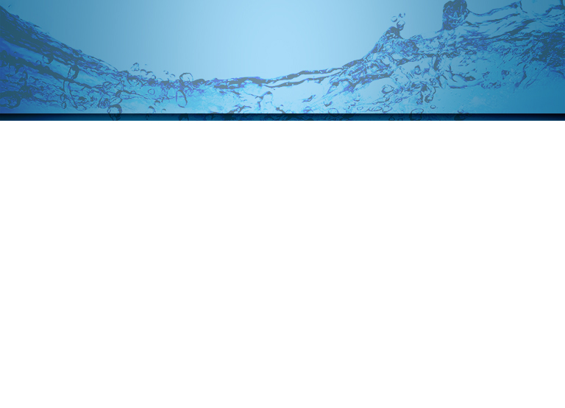
The fact that I’m alive today isn’t because of me; It’s because of the grace of God. It’s a miracle; I can’t explain it. Now I know I just live life to the best I can each day.
Evans Monsignac
Notes:
The fact that I'm alive today isn't because of me; it's because of the grace of God. It's a miracle; I can't explain it….Now I know I must live life to the best I can each day.”

Slide 7
In time of crisis
We are all thirsty when our lives are falling apart.
We are thirsty for a spiritual need that sustains us when all hope has been buried.
We don’t need to be the longest-ever without living water survivors.
God provides living water that helps us live beyond the fear of death
Notes:
This story reminded me that we all meet different kinds of disaster in our lives. When a crisis comes, we are tested for our spiritual survival. At the time of crisis we all are thirsty, not only for the immediate satisfaction of physical needs but also for another kind of water. We long for the water that can refresh us when our lives are falling apart, the water that can sustain us when all hope has been buried, the water that can help us live beyond fear of death. This water is so essential that sometimes the need even surpasses our need for physical water. http://www.telegraph.co.uk/news/worldnews/centralamericaandthecaribbean/haiti/7530686/Buried-for-27-days-Haiti-earthquake-survivors-amazing-story.html
Many cultures express this desire to have living water in their folk epics, legends, and fairy tales. The heroes in these narratives went for long journeys to get this kind of water, they sacrificed, and they fought for it. It was believed that the one who got it would be unbeatable, powerful, and immortal.
Interestingly, the Bible also addresses this kind of human need and our thirstiness for this kind of water. In spiritual terms, there is no need for us to become the longest-ever without living water survivors. And God does not want us to feed ourselves with sewage water. He has shown us the source of fresh and living water. We don’t need to pay for it; living water from Jesus is free and available for all who are thirsty today, for all who are prospering or are in crisis. God only desires to see us coming for it regularly each day since it is essential for our spiritual wellbeing and survival.

Slide 8
On the last and greatest day of the Feast, Jesus stood and said in a loud voice, “If anybody is thirsty, let him come to me and drink. Whoever believes in Me, as the Scripture has said, streams of living water will flow from within him.” By this he meant the Spirit, whom those who believed in Him were later to receive.
John 7:37-39
Notes:
Bible Texts and Message
Let us look more closely at one such Bible passage where living water is mentioned, John 7:37-39: “On the last and greatest day of the Feast, Jesus stood and said in a loud voice, ‘If anybody is thirsty, let him come to me and drink. Whoever believes in Me, as the Scripture has said, streams of living water will flow from within him.’ By this he meant the Spirit, whom those who believed in Him were later to receive.”

Slide 9
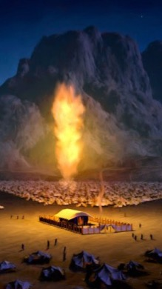
Feast of Tabernacles
All Jews journeyed to Jerusalem and built green booths made with tree branches:
In the courts of the temple.
In the city streets and housetops.
In the surrounding hills and valleys.
Notes:
Do you know the context of the passage when Jesus said these well-known words? It was in the Jerusalem temple during the Feast of Tabernacles. The Feast of Tabernacles was one of the most beautiful and loved holidays in the Jewish nation. It was the last of the main big holidays of the year and fell at the time when the harvest was gathered and people had the opportunity to rest and reflect on all the blessings that God bestowed on them. During seven days of the holiday, they lived in the booths made from tree branches, and the whole of Jerusalem looked like a green forest. The green booths “were erected in the streets, in the courts of the temple, or on the housetops.” And even “the hills and valleys surrounding Jerusalem were also dotted with these leafy dwellings, and seemed to be alive with people” (E. G. White, Desire of Ages, p. 448).

Slide 10
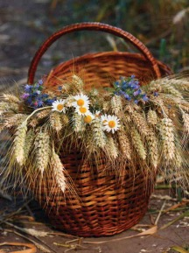
Feast of Tabernacles
1. The Feast was a time of gratitude for:
God’s care and protection during the Exodus and in the wilderness.
God’s blessing and harvest in Israel, even when not as abundant as other years.
Notes:
The Feast of Tabernacles played several functions for people of Israel:
1. First of all, it was a time of gratitude. During these days, people thanked the Lord for His care and blessings in the past and present. They remembered how He protected the people of Israel and cared for them during their journey to the Promised Land. Their clothes and shoes were not worn out, and God’s manna fell from above each day to feed them (Deut. 8:3-4). And now when the harvest was gathered, they had an opportunity to express their gratitude for God’s care and blessings during the last year by bringing some goods of the harvest to the Lord as a token of gratitude. These offerings pointed to the main source of their blessings. Of course, some years were more fruitful than others, but the annual Feast of Tabernacles suggested that in spite of quantity of the harvest, in spite of the expectations, in spite of rich or poor harvest of their neighbors, people would go to the Lord and thank Him for the goods they received. Additionally, the Feast of Tabernacles was also a sign of their trust into the Lord, their faith that He would continue to protect and care for them in the future.

Slide 11
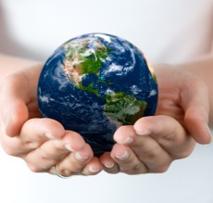
Feast of Tabernacles
2. The Feast was a universal gathering of the people of God:
From all the corners of Palestine.
From all the countries of the world.
Notes:
2. The Feast of Tabernacles had also another characteristic. It was a universal gathering of the people of God. All—young and old, rich and poor, living in the north, south, east, and west, inside or abroad—were to come to Jerusalem and reunite again with the people of God. Thus, people from all corners of Palestine and from the countries of their current dwelling were coming to Jerusalem to celebrate together the Feast of Tabernacles. This also was a symbol of heavenly gathering, the future Feast of Tabernacles, when all the redeemed will be gathered on the glass sea—there will be place for all—rich and poor, young and old, from the west and east, north and south. They all will be equally precious and welcome in that heavenly Promised Land.

Slide 12
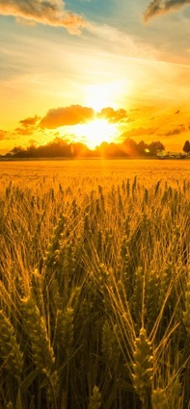
Feast of Tabernacles
3. The Feast was a symbol of the temporal character of their life:
In the Egypt and in the wilderness.
In the promised land, because they were still on the journey to heaven.
Notes:
3. The Feast of Tabernacles was also a symbol of the temporal character of their life on this earth. The days and nights in the booths during this beautiful holiday were to remind them about their life in the wilderness, and even more importantly, to point out that they were still on their journey to the heavenly Promised Land, that even now they were not home yet. The annual regularity of the Feast of Tabernacles was to remind them again and again that this earth was not a point of their destination; the journey was to continue until they meet their Savior face to face.

Slide 13
Feast of Tabernacles
4. The Feast was a holiday filled with peace, joy, and beauty.
People felt forgiven and at peace following the Day of Atonement.
People rejoiced and rested after the harvest.
People enjoyed their relationships with each other and with THE LORD.
Notes:
4. The Feast of Tabernacles was a holiday filled with peace, joy, and beauty. By God’s grace and wisdom, the Day of Atonement was scheduled to precede rather than follow it. And at the Feast of Tabernacles people already felt forgiven and at peace with the Lord. This allowed them to enjoy the holiday fully and express their joy and gratitude to the Lord because there were no obstacles to their rejoicing. They could enjoy everything, especially their relationships with the Lord and with each other.

Slide 14
People who experience God’s forgiveness and grace manifest inner harmony of soul with the LORD.
Notes:
This important dimension of being at peace with the Lord and rejoicing in His presence found its expression in beautiful ceremonies and praises to the Lord. As Ellen White described it:
“The temple was the center of universal joy. Here was the pomp of the sacrificial ceremonies. Here, ranged on either side of the white marble steps of the sacred building, the choir of Levites led the service of song. The multitude of worshipers, waving their branches of palm and myrtle, took up the strain, and echoed the chorus; and again the melody was caught up by voices near and afar off, till the encircling hills were vocal with praise. At night the temple and its court blazed with artificial light. The music, the waving of palm branches, the glad hosannas, the great concourse of people, over whom the light streamed from the hanging lamps, the array of the priests, and the majesty of the ceremonies, combined to make a scene that deeply impressed the beholders” (E. G. White, Desire of Ages, p. 448).
The beauty of the holiday filled with music, songs, Levite choir, temple ceremonies, palm and willow branches, etc., pointed to the beauty, harmony, and joy that the presence of the Lord could bring in the lives of His people. People who experience God’s forgiveness and grace manifest inner harmony of soul with the Lord. Their hearts cannot stop praising Him, and they radiate this peace and joy. Thus, the holiday stood as a symbol of the Christian life now and also in the future, in the presence of the Lord.

Slide 15
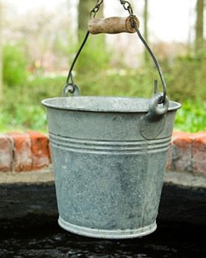
Feast of Tabernacles
5. THE FEAST WAS A REMINDER THAT THE LORD IS:
The source of salvation.
The source of living water.
Notes:
5. Although the Feast of the Tabernacles was to remind people about God’s presence in their past and present journey, it had even greater function. It was to remind them about Jesus as a source of salvation and a source of living water.

Slide 16
Daily ceremony during the Feast
Priests sounded the silver trumpets.
People shouted from their booths.
Priest filled one flagon dipped in the waters of the Kedron, and another flagon with wine.
Priest ascended the steps of the temple, keeping time with the music with slow measured tread, chanting, “Our feet shall stand within thy gates, O Jesusalem” (Psalm 122:2), and bore the flagons to the altar.
Notes:
To do so, a special ceremony opened the Feast of Tabernacles. Ellen White describes it as follows:
“At the first dawn of day, the priests sounded a long, shrill blast upon their silver trumpets, and the answering trumpets and the glad shouts of the people from their booths, echoing over hill and valley, welcomed the festal day. Then the priest dipped from the flowing waters of the Kedron a flagon of water, and, lifting it on high, while the trumpets were sounding, he ascended the broad steps of the temple, keeping time with the music with slow and measured tread, chanting meanwhile, ‘Our feet shall stand within thy gates, O Jerusalem.’ Ps. 122:2.

Slide 17
Daily ceremony during the Feast
Two silver basins were positioned next to the altar with a priest standing at each one.
The flagon of water was poured into one basin and the flagon of wine was poured into the other basin.
The contents of both basins flowed into a pipe which communicated with the Kedron, and was conducted to the Dead Sea.
Notes:
He bore the flagon to the altar, which occupied a central position in the court of the priests. Here were two silver basins, with a priest standing at each one. The flagon of water was poured into one, and a flagon of wine into the other; and the contents of both flowed into a pipe which communicated with the Kedron, and was conducted to the Dead Sea.

Slide 18
Daily ceremony during the Feast
This display of consecrated flowing water and wine
Represents the fountain that gushed from the rock in the desert for all who were thirsty.
Represents the flowing of the Messiah’s blood for the salvation of all who are thirsty.
Notes:
This display of the consecrated water represented the fountain that at the command of God had gushed from the rock to quench the thirst of the children of Israel. Then the jubilant strains rang forth, ‘The Lord Jehovah is my strength and my song; therefore with joy shall ye draw water out of the wells of salvation’ Isa. 12:2, 3” (E. G. White, Desire of Ages, pp. 448-449).
This ceremony performed daily during the Feast of Tabernacles represented Christ as the rock from which the children of Israel received water in the wilderness and also as the sacrifice necessary for their salvation. Jesus the Messiah was the center of this holiday. “That rock was a symbol of Him who by His death would cause living streams of salvation to flow to all who are athirst… In smiting Christ, Satan thought to destroy the Prince of life; but from the smitten rock there flowed living water” (E. G. White, Desire of Ages, p. 454).

Slide 19
It was on the last day of this holiday that Jesus said these words: “If anybody is thirsty, let him come to me and drink. Whoever believes in Me, as the Scripture has said, streams of living water will flow from within him” (John, 7:37-38). We read in the book Desire of Ages that these words made a deep impression on those who heard them:
Notes:
It was on the last day of this holiday that Jesus said these words: “If anybody is thirsty, let him come to me and drink. Whoever believes in Me, as the Scripture has said, streams of living water will flow from within him” (John, 7:37-38). We read in the book Desire of Ages that these words made a deep impression on those who heard them:

Slide 20
“Many of those who heard Jesus were mourners over disappointed hopes, many were nourishing a secret grief, many were seeking to satisfy their restless longing with the things of the world and praise of men; but when all was gained, they found that they had toiled only to reach a broken cistern, from which they could not quench their thirst”. “Jesus knew the wants of the soul. Pomp, riches, and honor cannot satisfy the heart” (p. 454).
Notes:
“Many of those who heard Jesus were mourners over disappointed hopes, many were nourishing a secret grief, many were seeking to satisfy their restless longing with the things of the world and praise of men; but when all was gained, they found that they had toiled only to reach a broken cistern, from which they could not quench their thirst”. “Jesus knew the wants of the soul. Pomp, riches, and honor cannot satisfy the heart” (p. 454).
Interestingly, Jesus went even further with these symbols. He promised that living water cannot only satisfy the thirstiness of those who drink from the Rock but also fill a person so that he or she will become streams of living water.

Slide 21
People who are going to the heavenly Feast of Tabernacles:
Will practice the principle of gratitude.
Will rightly understand and contribute to the universal character of God’s kingdom.
Notes:
Application of the Message
And what about us? How relevant is this story to us living in the 21st century? Does the Feast of Tabernacles from Bible times have anything to do with us today?
No doubt, Jesus’ invitation at that holiday is still relevant. Through that feast He speaks to us. The symbols of the Feast of Tabernacles should become a reality in the lives of those are going to the future Feast on the sea of glass and who will drink from the Rock. Those who drink the living water will manifest in their lives the principles of this great holiday. Let us look at the application of these principles to our lives:
People who are going to the heavenly Feast of Tabernacles will practice the principle of gratitude. How often do we remind ourselves that all good things come from our Father who is in heaven? How often are we thankful for all we have even when our neighbors have more? Do we find time to talk about our blessings with Jesus? Do we share our gratitude and testimonies with people around us? Do we know the benefit of the grateful heart that becomes a blessing to us by itself? Let’s remember that Bible teaches us to always be grateful and contented. The more living water we take in, the more grateful and trusting in God we will become.
People who are going to the heavenly Feast of Tabernacles will rightly understand and contribute to the universal character of God’s kingdom. Do I manifest in my life this belief that the Lord is the Lord of all people? Do I contribute to the universal character of the future Feast of Tabernacles, where people will be gathered from all parts of the world, all nations, all social and age groups? What kind of people can I welcome and lead to this future Feast in the heavenly Promised Land? They all are thirsty. They all need this living water that I know about. Jesus said, “If anybody is thirsty.” Anybody—with no racial, social, or religious limits. The water is free for all. But as apostle Paul said: “And how are they to believe in him of whom they have never heard? And how are they to hear without someone preaching?” (Rom. 10:14).

Slide 22
People who are going to the heavenly Feast of Tabernacles:
WILL UNDERSTAND THE TEMPORAL CHARACTER OF OUR LIFE HERE.
WILL PRACTICE THE PRINCIPLES OF PEACE, JOY, AND BEAUTY.
WILL BECOME THEMSELVES STREAMS OF LIVING WATER.
Notes:
People who are going to the heavenly Feast of Tabernacles will understand the temporal character of our life here. Someone said that we all live on the bridge that connects us with eternity, but often we forget this and build permanent houses instead of tents on this bridge. Do we remember that all that really matters is what we can take with us to eternity—our characters, our children, and people we love. Let us make this a priority and make sure that we are moving ahead on this bridge towards eternity together with those we love and care about.
People who are going to the heavenly Feast of Tabernacles will practice principles of peace, joy, and beauty. Have you noticed that people who are at peace with the Lord and others usually are very joyful and able to bring joy, encouragement, and beauty to the lives of those around them? If you don’t find it in your heart to sing praises to the Lord, to share joy and beauty with others, think about your personal “Day of Atonement.” How long ago did you have it? Do you need one? Do you feel forgiven and forgiving? Usually those who feel hurt also hurt other people. Broken vessels cannot be a source of living water. Broken cisterns cannot hold living water. Dry wells cannot give living water to those who are thirsty. We need to be at peace with the Lord to be able to enjoy our life, to rejoice in service to the Lord and others, and to radiate joy and beauty.
People who are going to the heavenly Feast of Tabernacles will become themselves streams of living water. Their lives will demonstrate the fact that they are saved by the grace of Jesus and filled with the power of the Holy Spirit. Jesus spoke about the Holy Spirit when he said: “Whoever believes in me, as the Scripture has said, streams of living water will flow from within him” (John 7:38). We read: “By this he meant the Spirit, whom those who believed in Him were later to receive”(John 7:39). We are praying about the power of the Holy Spirit, we are waiting for the Latter Rain, but are we doing our part in receiving Him? Are we drinking daily from the Word of God in order to be filled with the living water and become these living streams?

Slide 23
Mixing the flowing wine and water
Flowing wine represents
Flowing water represents
Salvation
Death of Jesus
Shed blood
Symbol of the sacrifice of the Savior
Regeneration
New life
Quenched thirst
Symbol of the power of Holy Spirit
Notes:
The wine and the water in the Feast of Tabernacles were mixed together while flowing from the temple to the Dead Sea. One was a symbol of Jesus’ sacrifice, a symbol of his death; the other was a symbol of regeneration, new life, a symbol of the end of thirstiness, a symbol of power of the Holy Spirit. These two realities should go hand in hand in our spiritual lives too. We should die daily in Christ and rise again daily in Him to be able to offer living water to the Dead Sea of our world.
Let us ask ourselves: from what springs do I drink? Do I drink from broken cisterns? From sewage water as did Evans Monsignac? Or from the source of living water? The world is dying today from thirstiness, and nothing can satisfy the longing of hearts except the living waters that can regenerate the soul. Do I care about people who are thirsty and do not know where to find the source of living water?
In his conversation with woman of Samaria, Jesus emphasized the same thought when He said: “Everyone who drinks this water will be thirsty again, but whoever drinks the water I give him will never thirst. Indeed the water I give him will become in him a spring of water welling up to eternal life” (John 4:13).

Slide 24
Drinking daily from the living water
We will be able to offer living water to the Dead Sea of our world
If we die daily in Christ
And rise again daily in Christ
From what springs do I drink?
Broken cisterns
Sewage water
Living water
Notes:
Conclusion
The story is told of a little girl who underwent a surgery and was not allowed to drink after it for some time. She was in pain and thirsty but her mother refused to give her water when she asked for it. The little girl did not understand this; she wanted to drink and wanted it badly. Following the nurse’s instructions, the mother dipped a piece of cloth in water and wet her child’s lips. She suffered with her daughter but wanted her to recover soon and did not give her what she wanted. The girl fell asleep and soon awoke with a cry. “Why do you cry?” asked her mom. “What did you dream about?”
“I dreamed about an ocean full of water,” said the girl. “I went there. There was so much water, I wanted to drink but the water was so bitter and salty that I could not. Why?” she sobbed. “Why was there so much water if I could not drink it?”
Dear friends, unlike this little girl, we don’t need to suffer thirst any more. Jesus invites us to the fresh waters that can satisfy thirstiness of our hearts, regenerate our souls, and transform our lives.

Slide 25
The world is dying today from thirstiness, and nothing can satisfy the longing of hearts except the living waters that can regenerate the soul.
Notes:
Dear friends, unlike this little girl, we don’t need to suffer thirst any more. Jesus invites us to the fresh waters that can satisfy thirstiness of our hearts, regenerate our souls, and transform our lives.

Slide 26
The poor and needy search for water, But there is none; Their tongues are parched with thirst. But I the LORD will answer them; I, the God of Israel, will not forsake them.
Isaiah 41:17
Notes:
As the prophet Isaiah said: “The poor and needy search for water, but there is none; their tongues are parched with thirst. But I the Lord will answer them; I, the God of Israel, will not forsake them.

Slide 27
I will make rivers flow on barren heights, And springs within the valleys. I will turn desert into pools of water, And the parched ground into springs.
Isaiah 41:18
Notes:
I will make rivers flow on barren heights, and springs within the valleys. I will turn desert into pools of water, and the parched ground into springs” (Isa. 41:17-18). This living water will produce the invaluable fruits of the Holy Spirit in our lives, such as love, joy, peace, patience, kindness, goodness, faithfulness, gentleness, and self-control (Gal. 5:22-23).

