Slide 1
21 WAYS TO
BUILD
A STRONGER
SPIRITUAL LIFE
[SHINING WITHIN]
By Victor M. Parachin
Notes:
Written by Victor M. Parachin. Used by permission. http://www.vibrantlife.com/?p=199. “21 Ways to Build a Stronger Spiritual Life,” Spiritual Health, January 12.
Scripture quotations are taken from the Holy Bible, New Living Translation, copyright © 1996. Used by permission by Tyndale House Publishers, Inc., Wheaton, Illinois 60189. All rights reserved.

Slide 2


ARISE AND SHINE
Arise [and] shine, for your LIGHT is come! …
For behold, the darkness shall cover the earth,
And deep darkness the people;
But the Lord will arise over you,
And His glory will be seen upon you.”
Isaiah 60:1, 2, NKJV
Notes:
Arise [and] shine, for your LIGHT is come! …
For behold, the darkness shall cover the earth,
And deep darkness the people;
But the Lord will arise over you,
And His glory will be seen upon you.”
Isaiah 60:1, 2, NKJV
Before we can learn how to shine in this dark world, we must first understand what it means to make Jesus our rock, our refuge and our all in all. The 21 ways to build a stronger spiritual life will give you a path to walk as you rise and shine wherever God has placed you.
Because we live in a culture that increasingly leans toward commercialism, materialism, and secularism, it is not always easy to keep the soul nourished.
The challenge of these days, when times are not hospitable to spiritual growth, is how to nurture, feed, heal, restore, and renew the soul. Here are 21 practical suggestions for building a stronger spiritual life.

Slide 3

1. BE A RIVER, not a swamp.
Notes:
1. Be a river, not a swamp.

Slide 4

RIVERS OF LIVING WATER
“Rivers of living water
will flow from the heart
of anyone who believes in me.”
John 7:38, margin
Allow blessings to flow through you and on to others.
Notes:
“The Bible says: “Rivers of living water will flow from the heart of those who believe in me” (John 7:38, margin).* Remember, it is the mountain stream that carries fresh, life-giving water because it flows out. However, the swamp is stagnant and life-devouring. A swamp collects and retains water that comes its way. Don’t be the kind of person who seeks to accumulate much before allowing a little to flow through.
As Christians we are to let blessings flow through us and on to others. When we hoard and dam the blessings in our lives we are in danger of becoming spiritually stagnant, emotionally detached, and intellectually cynical. Resolve to break up the dam and let blessings flow like a river. The freshness is in the flow.
Allow blessings to flow through you and on to others.

Slide 5
2. IDENTIFY blessings.
Notes:
2. Identify blessings.
Too often we go through life oblivious to the good that comes flowing into our lives. Try this spiritual exercise for one week: At the end of the first day, identify a blessing that came to you from a family member. At the end of the second day, a blessing from a neighbor. Third day, from a friend. Fourth day, from a work colleague. Fifth day, from a stranger. Sixth day, from a child. On the seventh day, a blessing that came from an “enemy.”

Slide 6

Do not be oblivious to the good that comes flowing into your life.
Practice for one week identifying blessings you receive:
  From a family member
  From a neighbor
  From a friend
  From a work colleague
  From a stranger
  From a child
  From an “enemy”

Slide 7
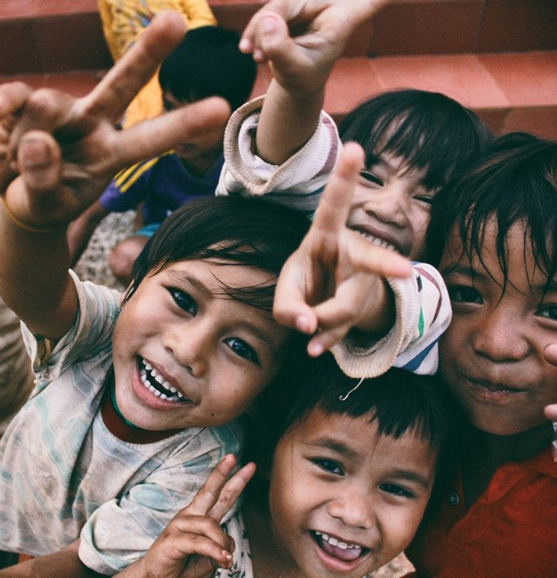
3. BE LIKE MOSES—
SPEAK words of blessing.
Notes:
3. Be like Moses—speak words of blessing.

Slide 8

“May the Lord bless you
and protect you.
May the Lord smile on you
and be gracious to you.
May the Lord show you his favor
and give you his peace.”
Numbers 6:24-26
Notes:
One of the most beautiful and compassionate passages in the Bible contains these words of blessing pronounced by Moses:
May the Lord bless you and protect you.
May the Lord smile on you and be gracious to you.
May the Lord show you his favor and give you his peace
(Numbers 6:24-26).
Get creative with language, and speak words that will uplift, encourage, hearten, and bless other people. As you build them up, your own spirit will get stronger.

Slide 9

4. NURTURE A shared prayer life.
Notes:
4. Nurture a shared prayer.

Slide 10

Increase the amount of time you spend in prayer by sharing in prayer with others.
Some ways to do this include:
Letting friends know you are always available for prayer.
Attending regularly held prayer groups.
Participating in a prayer chain.
Notes:
Increase the amount of time you spend in prayer by sharing in prayer with others. Some ways to do this include:
Letting friends know you are always available for prayer.
Attending regularly held prayer groups.
Participating in a prayer chain.

Slide 11

5. TAKE a step of faith.
Notes:
5. Take a step of faith.

Slide 12

Spiritual growth means taking a leap of faith from time to time.
Why not follow God’s leading and allow the plan to evolve?
Trust God to provide what may be needed for success.
Notes:
Spiritual growth means taking a leap of faith from time to time. Rather than trying to get everything in place before you start something important, why not follow God’s leading and allow the plan to evolve? This means taking a step of faith and trusting God to provide what may be needed for success.

Slide 13

6. RESTORE someone’s faith.
Notes:
6. Restore someone’s faith.

Slide 14

Make time to heal a wounded heart.
Make time to extend kindness to someone who needs a friend.
Make time to help gather up the pieces of a broken dream.
Make time to radiate God’s unconditional love.
Notes:
Today, make time to heal a wounded heart, to extend kindness to someone who really needs a friend, or to help gather up pieces of a broken dream. Today, do whatever you can to radiate God’s unconditional love.

Slide 15
7. BE A grateful person.
Notes:
7. Be a grateful person.

Slide 16
Begin each day with a morning prayer of gratitude to God for the gift of a new day.
Do this even if the day ahead appears ominous.
Conclude each day with an evening prayer of gratitude to God for the gift of the preceding hours.
Do this even if you’ve had a very tough day.
Notes:
Start every day with a morning prayer of gratitude to God for the gift of a new day. Do this even if the day ahead appears ominous. Conclude every day with an evening prayer of gratitude to God for the gift of the preceding hours. Do this even if you’ve had a very tough day.

Slide 17

8. SHARE the journey.
Notes:
8. Share the journey.

Slide 18

Hook up with one other person who is seeking to grow spiritually.
Agree to meet once a week for a period of time to study and reflect on spiritual matters.
Notice the spiritual growth taking place.
Notes:
Hook up with one other person who is seeking to grow spiritually. Agree to meet once a week for a period of time to study and reflect on spiritual matters. A friend of mine, who is a busy executive in Toronto, Ontario, met for six months with another man to do Bible study. “No matter how hectic our schedules, we always met each week during our lunch hour at a downtown church that kindly provided us with a room for our meeting. Those were good months when a lot of spiritual growth took place,” he says.

Slide 19

9. SERVE.
Notes:
9. Serve.

Slide 20

Look for ways to serve the community, especially tasks that promise no reward, such as picking up litter on the streets.
Read and reflect on the action of Jesus in John 13:1-5.
“Before the Passover celebration, Jesus knew that his hour had come to leave this world and return to his father. He had loved his disciples during his ministry on earth, and now he loved them to the very end. It was time for supper, and the devil had already prompted Judas, son of Simon Iscariot, to betray Jesus. Jesus knew that the Father had given him authority over everything and that he had come from God and would return to God. So he got up from the table, took off his robe, wrapped a towel around his waist, and poured water into a basin. Then he began to wash the disciples’ feet, drying them with the towel he had around him.”
Notes:
Look for ways to serve the community, especially tasks that promise no reward, such as picking up litter on the streets. Read and reflect on the action of Jesus in John 13:1-5.

Slide 21
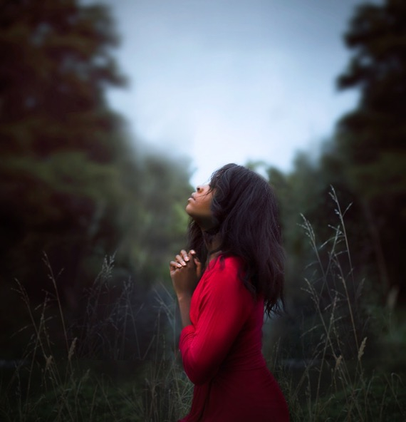
10. CULTIVATE A little solitude.
Notes:
10. Cultivate a little solitude.

Slide 22
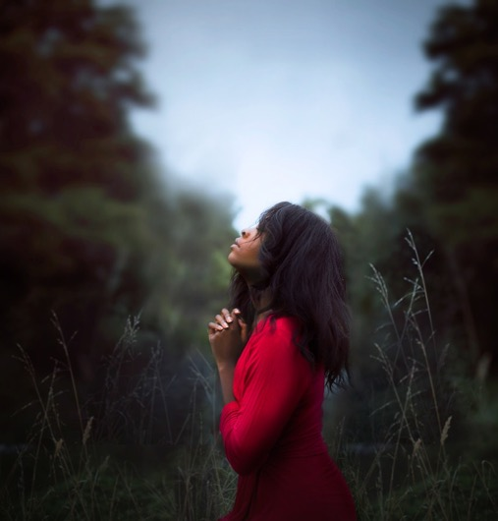
In quietness we turn our minds away from the problems of life and fix our thoughts on the mind of God.
Spend some time away from the crowd and noise of life.
Set aside a few minutes each day to be alone—just you and God.
Notes:
“Solitude makes us tougher toward ourselves and tenderer toward others; in both ways it improves our character,” noted philosopher Friedrich Wilhelm Nietzsche. Spend some time away from the crowd and the noise of life. Set aside a few minutes to be alone-just you and God. In quietness we turn our minds away from the problems of life and fix our thoughts on the mind of God.

Slide 23
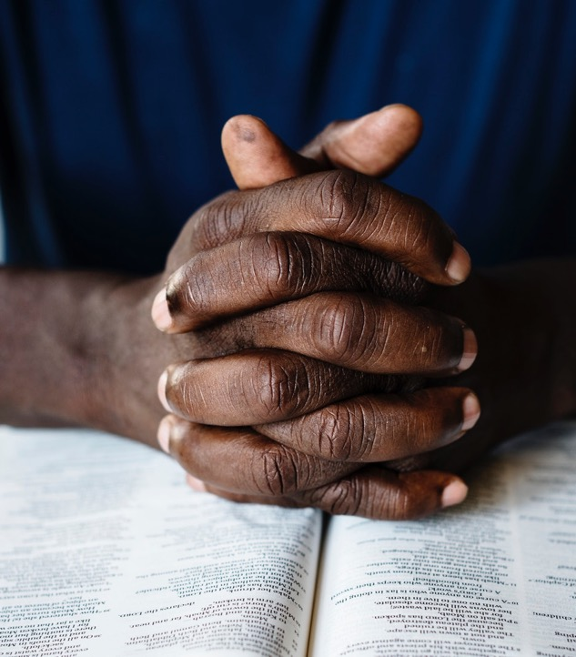
11. FAST and pray.
Notes:
11. Fast and Pray.

Slide 24
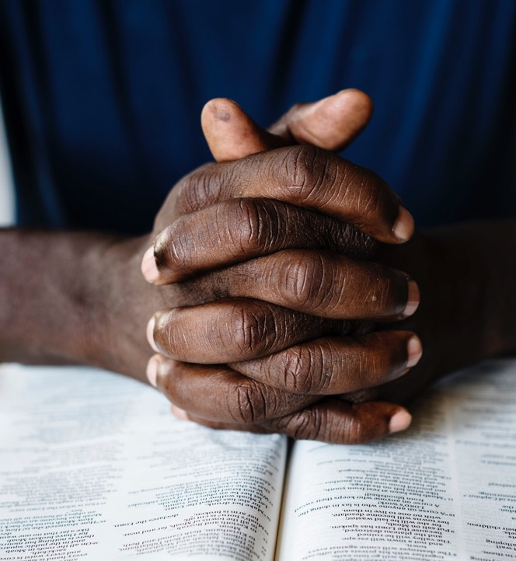
Prayer linked with fasting was often done by people in the Bible.
“So we fasted and earnestly prayed
that our God would take care of us,
and he heard our prayer.”
Ezra 8:23
The next time you are asked to pray urgently for someone in difficulty, consider combining your praying with some fasting.
Notes:
Prayer linked with fasting was often done by people in the Bible. Ezra 8:23 reports: “So we fasted and earnestly prayed that our God would take care of us, and he heard our prayer.” The next time you are asked to pray urgently for someone in difficulty, consider combining your praying with some fasting.

Slide 25


12. TURN WORRIES over to God.
Notes:
12. Turn worries over to God.

Slide 26

This is a clear teaching of Scripture:
“Give your burdens to the Lord, and he will take care of you” (Psalm 55:22). Do this each time a worry crops up.
Do this each time a worry crops up.
Notes:
This is a clear teaching of Scripture: “Give your burdens to the Lord, and he will take care of you” (Psalm 55:22). Do this each time a worry crops up.

Slide 27

13. SPREAD LOVE wherever you go.
Notes:
13. Spread love wherever you go.

Slide 28

Follow this advice from
Mother Teresa of Calcutta:
“Spread love everywhere you go;
First of all in your own house . . . .
Let no one ever come to you
without leaving better and happier.
Be the living expression of God’s kindness;
kindness in your face, kindness in your eyes,
kindness in your smile, kindness in your warm greeting.”
Notes:
That is the advice of Mother Teresa of Calcutta, who advised: “Spread love everywhere you go: First of all in your own house. . . . Let no one ever come to you without leaving better and happier. Be the living expression of God’s kindness; kindness in your face, kindness in your eyes, kindness in your smile, kindness in your warm greeting.”

Slide 29

14. KEEP YOUR priorities straight.
Notes:
14. Keep your priorities straight.

Slide 30

Know what is ultimately important and what is not.
Former U.S. President George Bush said, “I would like to be remembered for integrity, service, and family.”
Notes:
Know what is ultimately important and what is not. Consider the words of former President George Bush: “I am blessed with a close and wonderful family, and I want to spend the rest of my life letting them know how much I love them and appreciate them,” he said. “One of my most important accomplishments, one I am still working on, is to be a huge success in the grandfather business. I would like to be remembered for integrity, service, and family.”

Slide 31

15. STRIVE FOR excellence.
Notes:
15. Strive for excellence.

Slide 32

Be the best that you can be in whatever station in life God has placed you.
“Whatever you do, do well.”
Ecclesiastes 9:10
Notes:
The Bible tells us: “Whatever you do, do well” (Ecclesiastes 9:10). Be the best that you can be at whatever station in life God has placed you.

Slide 33

16. USE IT or lose it.
Notes:
16. Use it or lose it.

Slide 34

God has generously endowed you with unique gifts and talents.
Make use of them or you run the risk of losing them.
“Use your gifts faithfully,
and they shall be enlarged;
practice what you know,
and you shall attain to higher knowledge.”
Sir Edwin Arnold, nineteenth-century poet
Notes:
God has generously endowed each of us with unique gifts and talents. Make use of them or you will run the risk of losing them. “Use your gifts faithfully, and they shall be enlarged; practice what you know, and you shall attain to higher knowledge,” noted Nineteenth Century poet Sir Edwin Arnold.

Slide 35
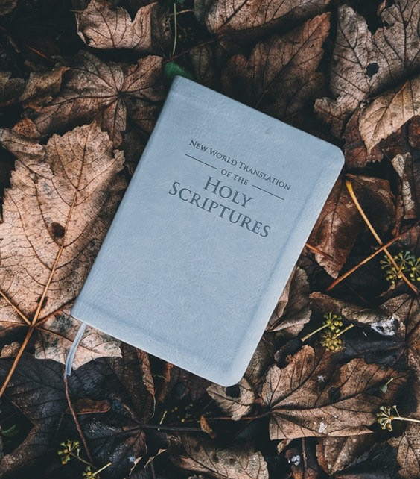
17. MEDITATE on scripture.
Notes:
17 Meditate on scripture.

Slide 36
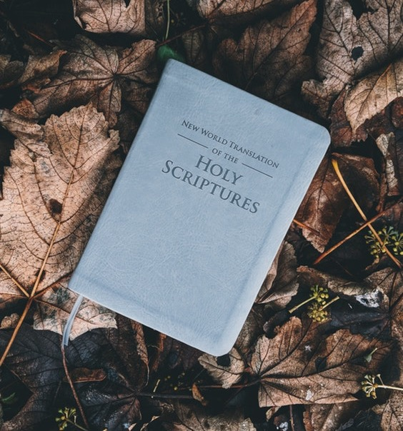
Make it a habit to read and study your Bible in a regular, disciplined way.
Highlight verses that speak to you.
Meditate on those words.
Memorize some of the passages so you can recall them from memory in the future.
Notes:
The Bible is loaded with verses of comfort, encouragement, and wisdom. Make it a habit to read and study your Bible in a regular, disciplined way. Highlight verses that speak to you. Meditate on those words. Memorize some of the passages so you can recall them from memory at a future time.

Slide 37

18. BE reliable.
Notes:
18. Be reliable.

Slide 38

Do what you say you will—whether it’s convenient or not.
Follow through on all your commitments, large and small.
By your actions, show others you are a person who can be trusted and counted upon.
Notes:
Do what you say you will do-whether it’s convenient or not. Follow through on all of your commitments, large and small. By your actions, show others you are a person who can be trusted and counted upon.

Slide 39
19. ASK GOD TO MAKE YOU A blessing today.
Notes:
19. Ask God to make you a blessing today.

Slide 40
A way to grow in wonder and amazement is by asking God to turn your life into a blessing.
Do this each morning before resuming your daily activities.
Offer a short, simple prayer: “Dear God, on this day make my life a blessing to someone, somewhere.”
Pay close attention to every person you encounter during the day, as God will honor your prayer, sometimes in surprising ways.
Notes:
A great way to grow in wonder and amazement is by asking God to turn your life into a blessing. Do this each morning before resuming your daily activities. Offer a short, simple prayer like this one: “Dear God, on this day make my life a blessing to someone, somewhere.” Then pay close attention to every person you encounter during the day, as God will honor your prayer, sometimes in surprising ways.

Slide 41

20. SPEND TIME in nature.
Notes:
20. Spend time in nature.

Slide 42

Psalm writers gleaned spiritual lessons from their time in nature.
“The heavens tell of the glory of God. The skies display his marvelous craftmanship.” Psalm 19:1
“When I look at the night sky and see the work of your fingers—the moon and start you have set in place—what are mortals that you should think of us, mere humans that you should care for us?” Psalm 8:3, 4
“Mountains rose and valleys sank to the levels you decreed. Then you set a firm boundary for the seas, so they would never again cover the earth.” Psalm 104:8, 9
Notes:
This was something done by the psalm writers, and they gleaned spiritual lessons from their time in nature. “The heavens tell of the glory of God. The skies display his marvelous craftsmanship” (Psalm 19:1). “When I look at the night sky and see the work of your fingers—the moon and the stars you have set in place—what are mortals that you should think of us, mere humans that you should care for us?” (Psalm 8:3,4). “Mountains rose and valleys sank to the levels you decreed. Then you set a firm boundary for the seas, so they would never again cover the earth” (Psalm 104:8, 9).

Slide 43

21. EXERCISE YOUR POWER of choice.
Notes:
21. Exercise your power of choice.

Slide 44

You always have freedom to choose, no matter what happens to you.
  Select joy over despair.
  Select love over hate.
  Select forgiveness over revenge.
  Select growth over stagnation.
A crisis can evoke the best in you or the worst in you. It will “make you” or “break you.” The choice is yours.
Notes:
No matter what happens to you, you always have the freedom to choose. You can select joy over despair. You can select love over hate. You can select forgiveness over revenge. You can select growth over stagnation. Remember that a crisis can evoke the best in you or the worst in you. The choice is yours!

Slide 45
ARISE AND SHINE
Arise [and] shine, for your LIGHT is come! …
For behold, the darkness shall cover the earth,
And deep darkness the people;
But the Lord will arise over you,
And His glory will be seen upon you.”
Isaiah 60:1, 2, NKJV
Notes:
Arise [and] shine, for your LIGHT is come! …
For behold, the darkness shall cover the earth,
And deep darkness the people;
But the Lord will arise over you,
And His glory will be seen upon you.”
Isaiah 60:1, 2, NKJV

