Slide 1
PLANT A SEED MINISTRY
[SHINING OUT]
For in this the saying is true:
“one sows and another reaps.”
John 4:37, NKJV
Written by Heather-Dawn Small, director
General Conference Women’s Ministries
Excerpt from Outreach Is for Everyone: Women’s Ministries Evangelism Manual
Notes:
Outreach is for Everyone: Women’s Ministries Evangelism Manual, Appendix J, “Plant a Seed Ministry,” written by Heather-Dawn Small (Silver Spring, Maryland: General Conference Women’s Ministries), 117, 118.
Additional Women’s Ministries Outreach resources:
Plant a Seed postcard and nine other ministry idea cards at:
https://women.adventist.org/ministry-idea-cards
Outreach Is for Everyone: Women’s Ministries Evangelism Manual at: https://women.adventist.org/outreach-is-for-everyone

Slide 2
“FOR IN THIS THE SAYING IS TRUE: ‘ONE SOWS AND ANOTHER REAPS.’”
JOHN 4:37, NKJV
Notes:
“For in this the say is true: ’One sows and another reaps’” (John 4:37, NKJV).
These words were spoken by Jesus to His disciples as He stood watching the Samaritan woman and the people whom she had told about Jesus come running to see Jesus. The disciples had returned, bringing food for Jesus to eat. But Jesus did not want earthly food. Instead He said, “My food is to do the will of Him who sent me, and to finish His work” (John 4:34, NKJV). Jesus knew His purpose on this earth was to do His father’s will. Do you know God’s will for your life?
As Jesus looked at the large group of people coming toward Him, He told the disciples that the harvest they thought was in the future was actually ready right now, that very day (see John 4:35).

Slide 3

‘one sows and another reaps’
John 4:37, NKJV
Notes:
But the next words Jesus spoke are the ones I want to focus on. He said to them, “And he who reaps receives wages, and gathers fruit for eternal life, that both he who sows and he who reaps may rejoice together. For in this the saying is true: ‘One sows and another reaps’” (John 4:36, 37, NKJV).

Slide 4

What did Jesus mean by these words? When we think of the cycle of planting and harvesting, it is not hard to understand His illustration and its application.
JESUS IS SAYING THAT THERE ARE PEOPLE WHO REAP WHO NEVER SOWED THE SEEDS.
Notes:
What did Jesus mean by these words? When we think of the cycle of planting and harvesting, it is not hard to understand His illustration and its application. Some people will sow the seeds of the gospel in people’s lives, and others will reap the results of the work someone else has done.
Do you fully understand the implications of what He is saying? Perhaps we have often felt that only certain people are called to sow the “good seed” of the gospel and also to do the reaping. We think of it as the work of just certain people, such as the pastor, the elders, evangelists, those gifted to do Bible studies, or trained Bible Workers. Many of us never think that we ourselves may be called by God to be the ones who sow—or perhaps reap. Those tasks, those responsibilities, were for other people, we think. But a careful look at these verses in John may change our perspective.
Jesus is saying that there are people who reap who never sowed the seeds.

Slide 5

“Go therefore and make disciples of all the nations, baptizing them in the name of the Father and of the Son and of the Holy spirit.”
Matthew 28:19, NKJV
Notes:
The question that comes to mind is, “Who did the sowing?” Whoever it was, they were focused on sowing. They did not mind that someone else would reap where they had sowed, that someone else got the credit. They were sowers, sharing the Good News of the Gospel.
Let’s look at another familiar text that talks about God’s purpose for our lives.
“Go therefore and make disciples of all the nations, baptizing them in the name of the Father and of the Son and of the Holy spirit” (Matthew 28:19 NKJV).

Slide 6
Here, God is calling all believers, every one of us, to go and tell the world. No doubt the way we tell, the way we share the gospel, will vary.
Notes:
Here, God is calling all believers, every one of us, to go and tell the world. No doubt the way we tell, the way we share the gospel, will vary. The gifts, talents, and abilities that God gives us vary. One person is a teacher, another a housewife, another a medical technician, another an architect. Whatever work you may be doing in order to pay the bills, remember that’s not your highest purpose. It is one avenue that God has given you to fulfill your life’s purpose. It is one avenue that God has given you to fulfill your life’s purpose, which is to “go” and tell the world about Jesus.
So the teacher tells her students through her kindness, her patience, her fairness. The housewife tells her family and her neighbors through her cooking, her hospitality, her concern for others, the example of her devotional life. A worker’s honesty, industry, calm temper, and even neatness, may preach a quiet sermon. And on and on.

Slide 7
There are many ways for us to plant seeds, but the best way is to plant seeds of love in the lives of people we meet.
Notes:
There are many ways for us to plant seeds, but the best way is to plant seeds of love in the lives of people we meet.
We may not know how to give a Bible study. We may not know how to convince someone that the seventh day is the Sabbath. But we can all plant seeds of love in someone’s life.

Slide 8

That was Jesus’ method (Ministry of Healing, p. 143). He focused on loving people to His father. He made genuine, caring friendships, and as a result people had confidence in Him. He cared about people enough that He did all He could to meet their needs. Jesus was planting seeds of love in people’s lives, and as a result hearts opened so that He could tell them about His father. Jesus was planting seeds of love. Can you do this? Yes, all of us can.
Notes:
A stranger, a co-worker, a friend, a family member, a neighbor. That was Jesus’ method (Ministry of Healing, p. 143). He focused on loving people to His father. He made genuine, caring friendships, and as a result people had confidence in Him. He cared about people enough that He did all He could to meet their needs. Jesus was planting seeds of love in people’s lives, and as a result hearts opened so that He could tell them about His father. Jesus was planting seeds of love. Can you do this? Yes, all of us can.
Now you may wonder, how can I plant seeds in someone’s life. Let me share some ideas.

Slide 9

Do you love to read? You could visit the elderly in a senior citizens home and spend time reading to them. Visit the hospital and read to those who can’t read for themselves. Someone in your neighborhood may be sick and would be happy for someone to read to them. That’s planting seeds of God’s love.
Notes:
Do you love to read? You could visit the elderly in a senior citizens home and spend time reading to them. Visit the hospital and read to those who can’t read for themselves. Someone in your neighborhood may be sick and would be happy for someone to read to them. That’s planting seeds of God’s love.

Slide 10

Do you love to cook? you can cook some food for someone you know who is sick. Or someone who has lost a loved one. You can teach some of your neighbors or coworkers to cook food that is healthful. You can bake bread and take it to a homeless shelter or a new neighbor. That’s planting seeds of love.
Notes:
Do you love to cook? you can cook some food for someone you know who is sick. Or someone who has lost a loved one. You can teach some of your neighbors or coworkers to cook food that is healthful. You can bake bread and take it to a homeless shelter or a new neighbor. That’s planting seeds of love.

Slide 11

Do you love to do crafts? You can make cards and give them to people whom you meet every day in the supermarket, the pharmacy, the hotel, the airport. Leave a card of thanks and encouragement for them with a few kind words and a text for their day. That’s planting seeds of love.
Notes:
Do you love to do crafts? You can make cards and give them to people whom you meet every day in the supermarket, the pharmacy, the hotel, the airport. Leave a card of thanks and encouragement for them with a few kind words and a text for their day. That’s planting seeds of love.

Slide 12
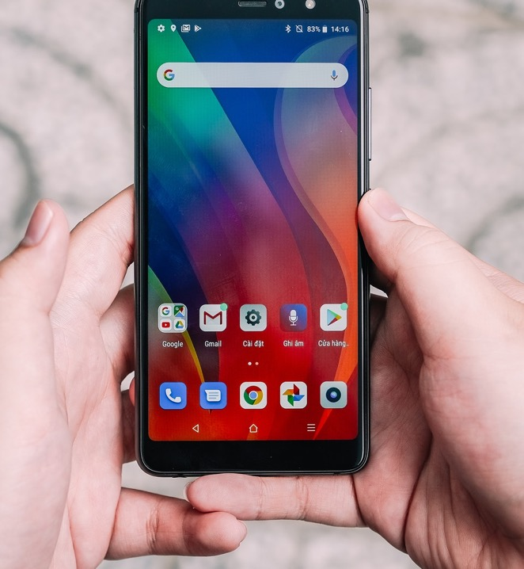
Are you elderly and unable to move around? You can take your telephone book and call some people each day and ask if you can pray for the problems in their lives. You’ll be amazed at how many people will tell a total stranger their problems and let you pray for them. That’s planting seeds of love.
Notes:
Are you elderly and unable to move around? You can take your telephone book and call some people each day and ask if you can pray for the problems in their lives. You’ll be amazed at how many people will tell a total stranger their problems and let you pray for them. That’s planting seeds of love.

Slide 13

Say thank you to the car park attendant with a smile. That’s planting seeds of love.
Notes:
Say thank you to the car park attendant with a smile. That’s planting seeds of love.

Slide 14

Do you love to listen? Then take time to listen to people who are desperate to unload their pain and their problems. There are many who are desperate for someone to listen to them and validate their feelings. That’s planting seeds of love.
Notes:
Do you love to listen? Then take time to listen to people who are desperate to unload their pain and their problems. There are many who are desperate for someone to listen to them and validate their feelings. That’s planting seeds of love.

Slide 15
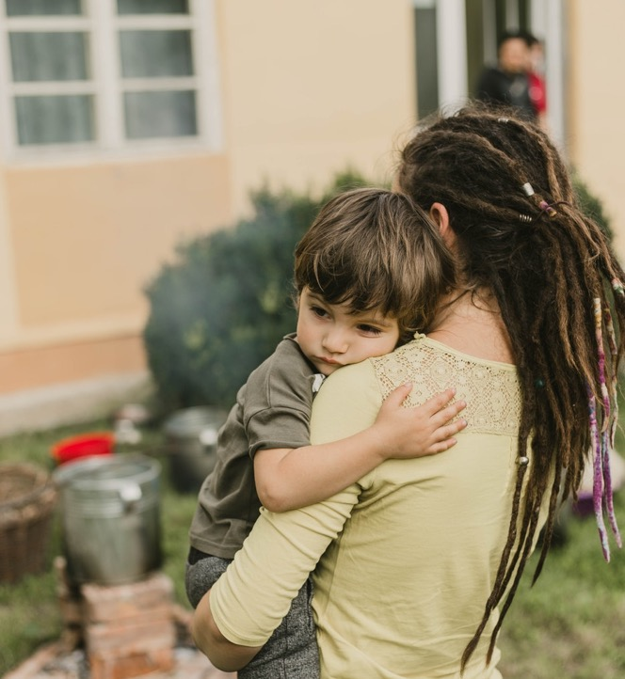
Volunteer to tutor some children in church or in your neighborhood who are having a difficult time keeping up in school. That’s planting seeds of love.
Notes:
Volunteer to tutor some children in church or in your neighborhood who are having a difficult time keeping up in school. That’s planting seeds of love.
You may never reap from the seeds you’ve planted. But that’s okay. When God uses us to plant a seed of His love in someone’s life, He will nurture it. He’ll send the rain, His Holy spirit, to help that little plant that grows from the seed. He’ll send other people to add some plant food, to nurture the plant as it grows until it reaches maturity. And then God will send the reapers. You many never see these people, but that’s okay. Jesus said, some will sow and some will reap .

Slide 16

ARE YOU ONE WHO REAPS OR ONE WHO SOWS?
Even if you feel that not many are called to reap, we are all called to sow. Every church member is called to be part of the great work of telling the world.
Notes:
Are you one who reaps or one who sows? Even if you feel that not many are called to reap, we are all called to sow. Every church member is called to be part of the great work of telling the world.

Slide 17
The question is, what are you doing? May God help you discover your part—as sower or reaper. And once you know this, go out and use the gift, the ability, the talent, that thing you love to do, to reach souls for Jesus
by planting seeds of love in their lives.
See Plant a Seed and nine other ministry card ideas:
https://women.adventist.org/ministry-idea-cards
Notes:
The question is, what are you doing? May God help you discover your part—as sower or reaper. And once you know this, go out and use the gift, the ability, the talent, that thing you love to do, to reach souls for Jesus by planting seeds of love in their lives.
Outreach Is for Everyone: Women’s Ministries Evangelism Manual, Appendix J, Plant a Seed, written by Heather-Dawn Small (Silver Spring, Maryland: General Conference Women’s Ministries), 117, 118.

