Slide 1
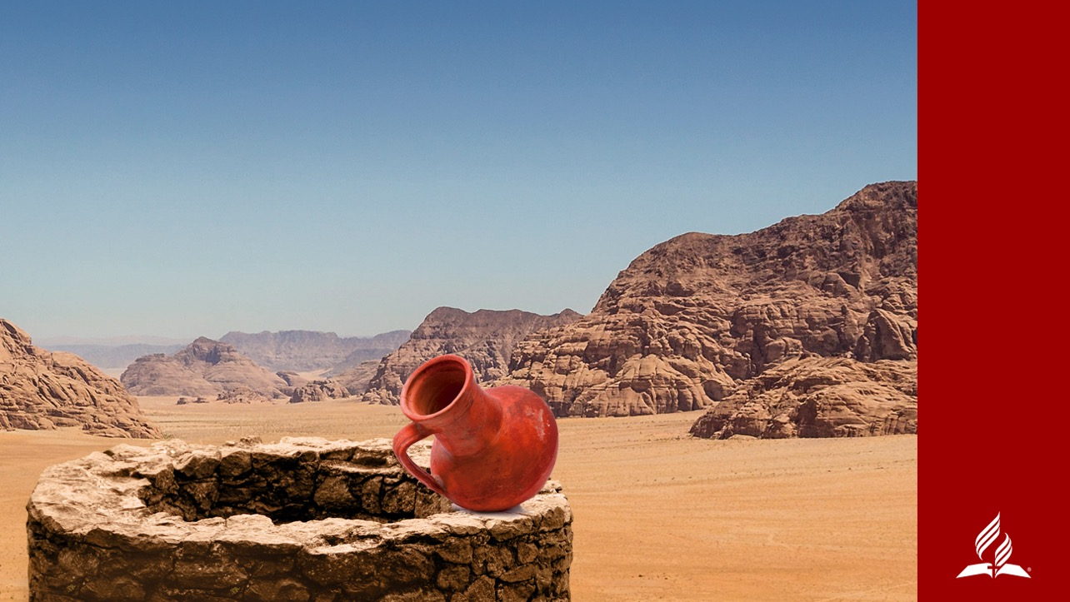
Come, See
THE SAVIOR OF THE WORLD
SERMON PREPARED BY SOUTH AMERICAN
DIVISON WOMEN’S M NISTRIES DEPARTMENT
WRITTEN BY PASTOR DAVI FRANÇA
Notes:
COME, SEE THE SAVIOR OF THE WORLD
Scripture passage: John 4:28-30, 39-42

Slide 2
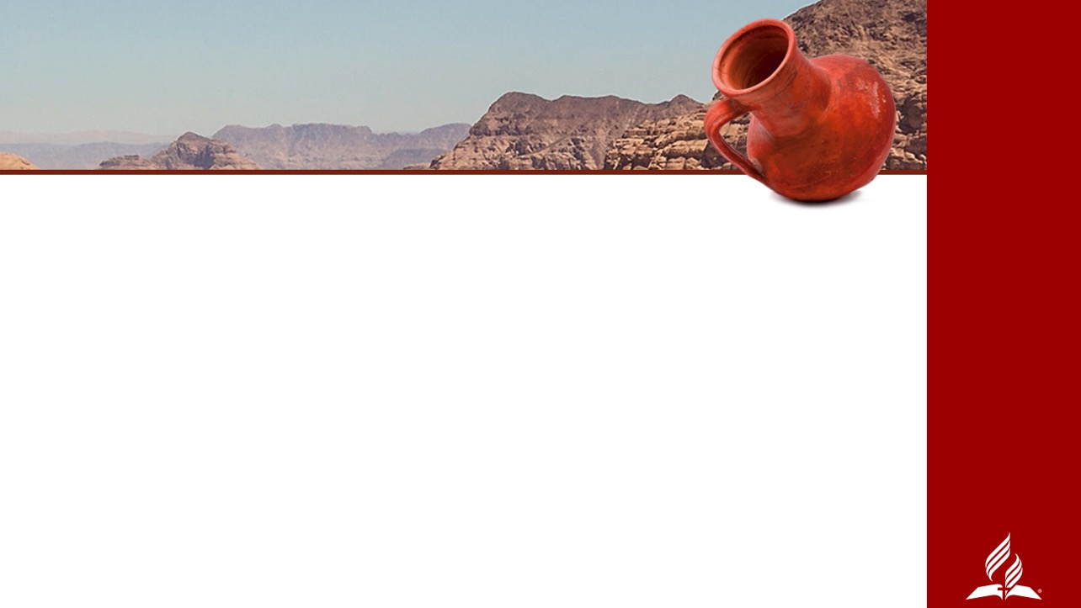
“WHERE ARE YOU STAYING?”
What did these two men want? Did they ask Him to preach His best evangelistic sermon or to give them a Bible study? Did they ask to see His ministerial credentials, or His seminary degree, or even His genealogical tree? No!
“Where are you staying?” The disciples understood the best way to get to know someone is to spend time with that person, to ask questions, to hear stories, to be present with him in his own environment.
Notes:
INTRODUCTION
The Gospel of John, chapter 1, records that when two of John the Baptist’s disciples heard him say “Look, the Lamb of God!” (John 1:36, NIV), the disciples followed the man John pointed out. When Jesus turned around and saw two men following him, He asked, “What do you want?” (v. 38).
What did these two men want? Did they ask Him to preach His best evangelistic sermon or to give them a Bible study? Did they ask to see His ministerial credentials, or His seminary degree, or even His genealogical tree? No!
They wanted to get to know Him, so they answered, “Where are you staying?” (v. 38). The disciples understood the best way to get to know a person is to spend time with that person, to ask questions, to hear stories, to be present with him in his own environment.

Slide 3
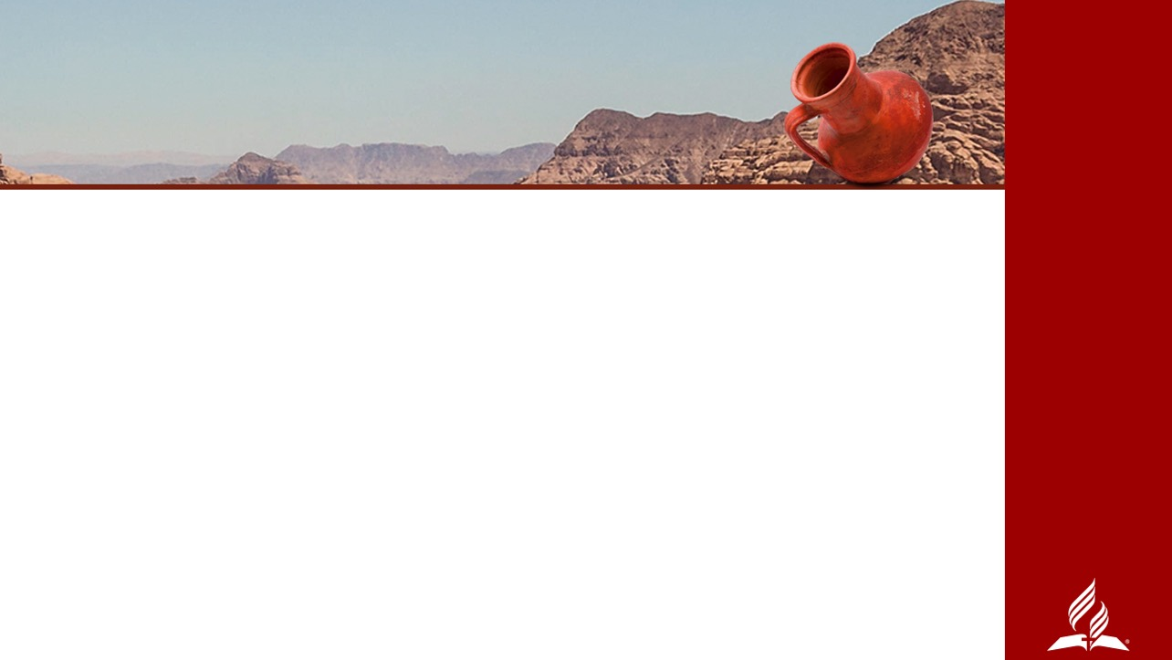
“COME,” HE REPLIED, “AND YOU WILL SEE.”
The encounter changed the men.
Immediately, Andrew invited his brother to meet the Messiah.
He didn’t give Simon directions and send him off alone in search of Jesus. Andrew himself brought Simon to Jesus.
Notes:
“Come,” He replied, “and you will see” (v. 39).
The encounter changed the men. Immediately, Andrew invited his brother to meet the Messiah. He didn’t give Simon directions and send him off alone in search of Jesus. Andrew himself brought Simon to Jesus.
The next passage of John 1 records the story of Philip meeting Jesus. Immediately, Philip found his friend Nathaniel and told him, “We have found [Messiah]...Jesus of Nazareth” (v. 45). Then, Philip himself took Nathaniel to Jesus by inviting his friend to “come and see” (vs. 46).
Recorded in John 4 is a story about a woman of Samaria who met Jesus at a well, and she also was changed by the encounter. Although she was an uneducated woman living in sin and had just then been introduced to Truth, she ran to the people she knew and invited them to come, see a man. Then she herself brought the people to Jesus, the Savior of the world.

Slide 4
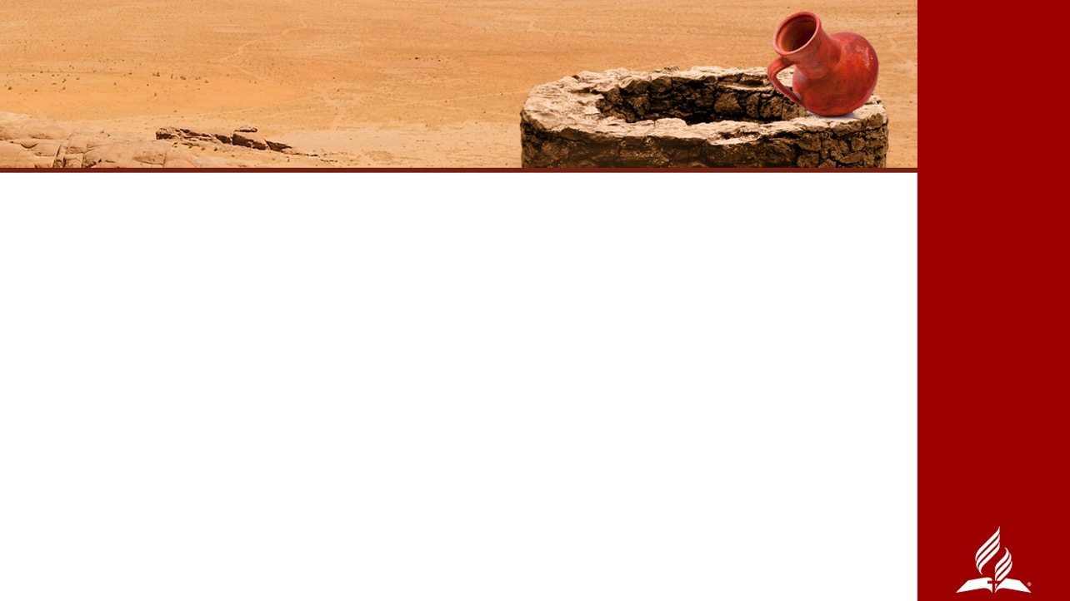
Today as we emphasize and celebrate women and their ministry, we will learn lessons through the story of the Samaritan woman—a marvelous woman whose name is not even recorded.
We will discover that every one of us—man, woman and child—can do what the woman of Samaria did, what Philip did, what Andrew did, and what Jesus did.
We can invite family, friends, and neighbors to COME, SEE Jesus!
Notes:
Today as we emphasize and celebrate women and their ministry, we will learn lessons through the story of the Samaritan woman—a marvelous woman whose name is not even recorded. We will discover that every one of us—man, woman, and child—can do what the woman of Samaria did, what Philip did, what Andrew did, and what Jesus did. No matter where we live, we can invite family, friends, and neighbors to COME, SEE Jesus!

Slide 5
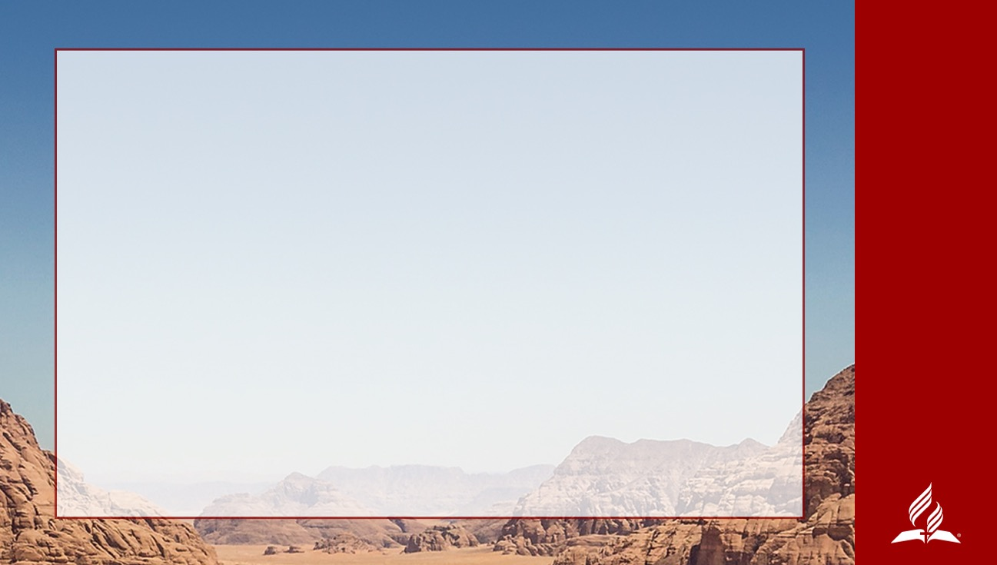
THE WOMAN AT THE WELL
²⁸ Then, leaving her water jar, the woman went back to the town and said to the people, ²⁹“Come, see a man who told me everything I ever did. Could this be the Christ?” ³⁰They came out of the town and made their way toward him.
³⁹Many of the Samaritans from that town believed in him because of the woman’s testimony, “He told me everything I ever did.” ⁴⁰So when the Samaritans came to him, they urged him to stay with them, and he stayed two more days. ⁴¹And because of his words, many more became believers.
⁴²They said to the woman, “We no longer believe just because of what you said; now we have heard for ourselves, and we know that this man really is the Savior of the world.”
John 4: 28-30, and 39-42, NIV
Notes:
THE WOMAN AT THE WELL
This is a familiar story, and we will only read a portion from the passage in John 4. I am reading verses 28-30, and 39-42 from New International Version.
²⁸Then, leaving her water jar, the woman went back to the town and said to the people, ²⁹“Come, see a man who told me everything I ever did. Could this be the Christ?” ³⁰They came out of the town and made their way toward him.
³⁹Many of the Samaritans from that town believed in him because of the woman’s testimony, “He told me everything I ever did.” ⁴⁰So when the Samaritans came to him, they urged him to stay with them, and he stayed two more days. ⁴¹And because of his words, many more became believers.
⁴²They said to the woman, “We no longer believe just because of what you said; now we have heard for ourselves, and we know that this man really is the Savior of the world.”

Slide 6
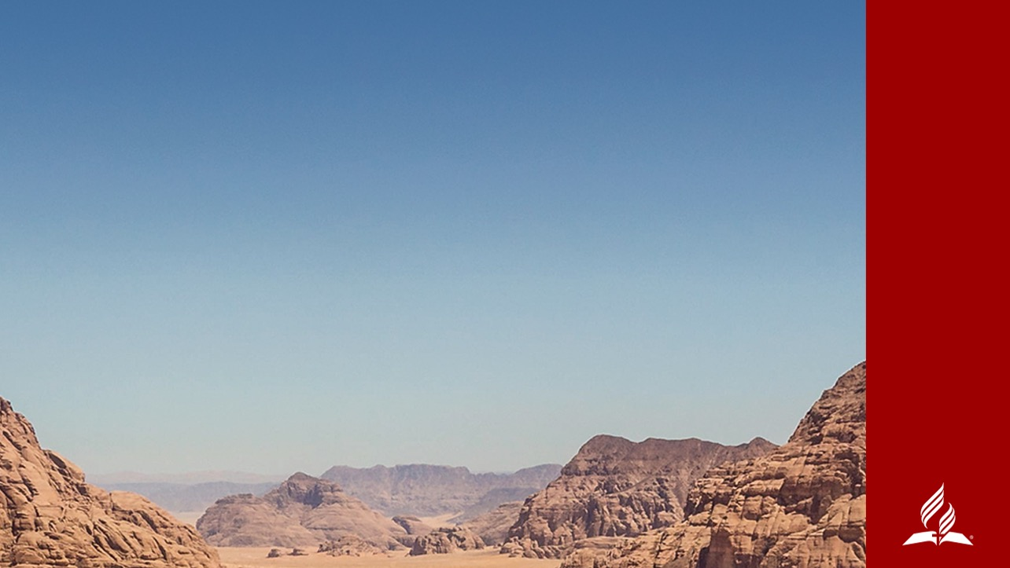
The story of the woman at the well shows us that to share the good news about Jesus, we don’t need to be perfect, we don’t need to know everything, we don’t need to go to distant lands.
WE CAN GO
Notes:
The Samaritan woman went to Jacob’s well at noontime to draw water for her household tasks. She expected to be alone, but when she arrived there, she found a man sitting by the well. Usually everything about her day went as she expected it to go. But this wasn’t just another trip to the well. That man wasn’t any other man. That day wasn’t like any other day. From the moment of her encounter with Jesus, the woman was not the same woman.
Like the Samaritan woman, when we meet Jesus, we become changed. When He sends us on a mission, “Go, call your husband” (John 4:16), or “Go, tell your family, your friends, and everyone you meet,” we can do what the Samaritan woman did. We can share how Jesus has transformed us.
WE CAN GO
One might ask, “Me? How?” Another might argue, “But I didn’t study theology.” Others might claim, “But I can’t go as a missionary.” Many might privately think, “But I have so many problems in my life I have nothing to share.” A few might confess, “But I’m not consecrated enough.” Some might even refuse, “I don’t believe God called me to fulfill a mission.”
The story of the woman at the well shows us that to share the good news about Jesus, we don’t need to be perfect, we don’t need to know everything, we don’t need to go to distant lands.

Slide 7

1. TO REACH OUR WORLD,
WE DON’T NEED . . . TO BE PERFECT
The Samaritan woman wasn’t perfect. The fact that she was going to the well to draw water at a time when she would not meet other women tells us that she knew she was far from perfect. Jesus’ statement about her married life reveals she wasn’t perfectly keeping the law. But the greatest evidence of something missing in her heart was the cry of her thirsty soul.
“Sir, give me this water so that I won’t get thirsty and have to keep coming here to draw water” (v. 15)
Notes:
1.TO REACH OUR WORLD, WE DON’T NEED . . . TO BE PERFECT
The Samaritan woman wasn’t perfect. The fact that she was going to the well to draw water at a time when she would not meet other women tells us that she knew she was far from perfect. Jesus’ statement about her married life reveals she wasn’t perfectly keeping the law. But the greatest evidence of something missing in her heart was the cry of her thirsty soul.
“Sir, give me this water so that I won’t get thirsty and have to keep coming here to draw water” (v. 15)

Slide 8
Instead of her imperfect life being the excuse, her imperfect life became the very substance of her message.
“Come, see a man who told me everything I ever did!” (v. 29).
TO REACH OUR WORLD,
WE DON’T NEED TO BE PERFECT.
Notes:
The Samaritan woman was living in sin. Guilt oppressed her heart. Her conscience constrained her mind. Prejudiced looks cut her soul. Going to the well when others were there was more than an embarrassing experience, it was humiliating. Day after day she couldn’t make sense of her existence. She was thirsty for something that water couldn’t quench. She was thirsty for love, for peace, for freedom, for joyous living!
If we were to choose a missionary to go to a region where the gospel had not yet been preached, we would not choose this woman. Indeed, she herself would not even think to join her own congregation in an outreach project. However, she began sharing her experience as soon as she met Jesus. The people to whom she spoke did not yet know Jesus; they only knew her. Her life did not become perfect, but when she met the perfect man, she became a different woman.
Instead of her imperfect life being the excuse, her imperfect life became the very substance of her message.
“Come, see a man who told me everything I ever did!” (v. 29).
To reach our world, we don’t need to be perfect.

Slide 9
2. TO REACH OUR WORLD,
WE DON’T NEED . . . TO KNOW EVERYTHING
The Samaritan woman didn’t know everything about religion. She had just met this Rabbi, and she had questions about the Bible. She was confused about how to worship God correctly. And although she was expecting the coming of Messiah, she wasn’t ready for the rendezvous with Him.
“I know that Messiah” (called Christ) “is coming. When he comes, he will explain everything to us” (v. 25).
Notes:
2. TO REACH OUR WORLD, WE DON’T NEED . . . TO KNOW EVERYTHING
The Samaritan woman didn’t know everything about religion. She had just met this Rabbi, and she had questions about the Bible. She was confused about how to worship God correctly. And although she was expecting the coming of Messiah, she wasn’t ready for today’s rendezvous with Him.
“I know that Messiah” (called Christ) “is coming. When he comes, he will explain everything to us” (v. 25).

Slide 10
We don’t need to know everything about Jesus, we only need to make Jesus known to others.
“Come, see a man . . . Could this be the Christ?” (v. 29).
TO REACH OUR WORLD,
WE DON’T NEED TO KNOW EVERYTHING.
Notes:
In addition to our imperfect lives being an excuse not to go reach our world, lack of knowledge or ability is also an excuse. “I don’t know how to give Bible studies!” “I’m shy, and I don’t like talking to people!” “I don’t know the Bible well!” “I’m too old for that!” “I’m too young for that!” How many of us have heard or said phrases like these? We use our limitations as a limiter to our involvement in ministry.
All we need to know about Jesus is this, He knows everything about us—and loves us still. What matters is not how much we know, but how much of what we know impacts our lives.
We don’t need to know everything about Jesus, we only need to make Jesus known to others.
“Come, see a man . . . Could this be the Christ?” (v. 29).
To reach our world, we don’t need to know everything.

Slide 11
3. TO REACH OUR WORLD,
WE DON’T NEED . . . TO GO FAR
The impact of the message and the presence of Jesus caused the Samaritan woman to drop her burden at His feet. She left her water jar and immediately returned home. Did she run away in fear? No! She ran away in freedom. She ran to her home and neighborhood with freedom and urged people to come with her to the well.
Notes:
3. TO REACH OUR WORLD, WE DON’T NEED . . . TO GO FAR
The impact of the message and the presence of Jesus caused the Samaritan woman to drop her burden at His feet. She left her water jar and immediately returned home. Did she run away in fear? No! She ran away in freedom. She ran to her home and neighborhood freed from her burden and urged people to come with her to the well.
First, she shared Jesus at home by going to get her “husband.” Then she talked about Jesus to her neighbors. Finally, she gave her testimony to her entire city.
The Samaritan woman’s greatest concern was bringing people to Jesus. The disciples’ greatest concern was bringing bread to Jesus, the Bread of Life.
“They came out of the town and made their way toward him. Meanwhile his disciples urged him, ‘Rabbi, eat something’” (vs. 30, 31).

Slide 12
But we must allow Jesus to use our transformed lives to transform the lives of our family, friends, and neighbors.
“Many of the Samaritans from that town believed in Him because of the woman’s testimony” v. 39.
TO REACH OUR WORLD,
WE DON’T NEED TO GO FAR.
Notes:
Brothers and sisters, the greatest center of influence for each one of us is with our family and neighbors. They watch us. They know us. The way we live—we preach. They can understand that if Jesus has power to transform our messy lives, He also has power to transform their messy lives.
Our greatest difficulty in going to an unreached region is giving the same excuse we often use to avoid becoming involved in local ministry. “Doors aren’t opening.” “Too many stony hearts are there.” “Everyone has a secularized mind.” These obstacles are presented as barriers for sharing the gospel.
But we must allow Jesus to use our transformed lives to transform the lives of our family, friends, and neighbors.
“Many of the Samaritans from that town believed in Him because of the woman’s testimony” v. 39.
To reach our world, we don’t need to go far.

Slide 13
We have learned that we CAN go reach our world, but we do not need to be perfect, we do not need to know everything, and we do not need to go far.
The Samaritan woman’s story also shows us that we can make a difference by HOW we invite others to come, see the Savior. We need to prioritize what is most important, we need to share our testimony, and we need to focus on Jesus, not ourselves.
HOW WE GO
Notes:
We have learned that we CAN go reach our world, but we do not need to be perfect, we do not need to know everything, and we do not need to go far. The Samaritan woman’s story also shows us that we can make a difference by HOW we invite others to come, see the Savior. We need to prioritize what is most important, we need to share our testimony, and we need to focus on Jesus, not ourselves.
HOW WE GO

Slide 14
1. TO MAKE A DIFFERENCE,
WE NEED . . . TO PRIORITIZE
When we leave our burden at the feet of Jesus, our priority list transforms from carrying burdens to carrying the good news.
Notes:
TO MAKE A DIFFERENCE, WE NEED . . . TO PRIORITIZE
The impact of meeting Jesus totally changed the scales of values for the Samaritan woman. Her day’s priority list immediately changed. Despite being important, the water she went to draw was not needed that afternoon because household tasks weren’t as important as sharing the good news. The abandoned water jug is a powerful external symbol of what happened inside the woman’s heart.
When we leave our burden at the feet of Jesus, our priority list transforms from carrying burdens to carrying the good news.

Slide 15
If ministry is more important than any other area of our lives, ministry will be part of every other area of our lives.
“Then, leaving her water jar, the woman went back to town” (v. 28).
TO REACH OUR WORLD,
WE NEED TO PRIORITIZE.
Notes:
The woman adopted Jesus’ priority list. For Jesus, the harvesting of hearts was more important than eating and drinking. For the Samaritan woman, the saving of souls was more important than drawing water or eating her noonday meal.
If ministry is more important than any other area of our lives, ministry will be part of every other area of our lives.
“Then, leaving her water jar, the woman went back to town” (v. 28).
To reach our world, we need to prioritize.

Slide 16
2. TO MAKE A DIFFERENCE,
WE NEED… TO SHARE OUR TESTIMONY
The woman didn’t preach a sermon; she presented her argument. “He told me everything that I ever did.” The logic is this: the people of the city suspected her lifestyle and judged her. Although Jesus knew everything she had ever done, He loved her still.
Notes:
2. TO MAKE A DIFFERENCE, WE NEED . . . TO SHARE OUR TESTIMONY
The woman didn’t preach a sermon; she presented her argument. “He told me everything that I ever did.” The logic is this: the people of the city suspected her lifestyle and judged her. Although Jesus knew everything she had ever done, He loved her still. Despite being simple, her testimony was powerful.
People who knew the Samaritan woman could not deny the sudden transformation they witnessed. Sad eyes that never looked into the eyes of others because of her shame now sparkled because of hope that ignited the fire of her heart.
Although she returned from the well empty-handed, her heart was full, brimming over with joy! By offering living water, Jesus was offering His grace to her. Everyone in town could see that she was, in fact, different.

Slide 17
When a person is evangelized, the person becomes an evangelist.
“We no longer believe just because of what you said; now we have heard for ourselves and we know . . . (v. 42).
TO REACH OUR WORLD, WE NEED TO SHARE OUR TESTIMONY.
Notes:
There is no way to deny the power of a life touched by Christ’s grace. If your life has been transformed by God’s power, you need to share that truth! You need to allow people to see the difference that Christ makes in your life. People need to know that Jesus accepts and offers His grace to them also.
When a person is evangelized, the person becomes an evangelist.
“We no longer believe just because of what you said; now we have heard for ourselves and we know . . . (v. 42).
To reach our world, we need to share our testimony.

Slide 18
3. TO MAKE A DIFFERENCE,
WE NEED . . . TO FOCUS ON JESUS
The Samaritan woman didn’t say, “I have just had the most incredible personal experience of my life.” She simply said, “Come, see a man.” This is one of the best ways to present a personal testimony. Her testimony aroused curiosity, but the focus of her message was the person of Jesus.
Notes:
3. TO MAKE A DIFFERENCE, WE NEED . . . TO FOCUS ON JESUS
The Samaritan woman didn’t say, “I have just had the most incredible personal experience of my life.” She simply said, “Come, see a man.” This is one of the best ways to present a personal testimony. Her testimony aroused curiosity, but the focus of her message was the person of Jesus.

Slide 19
We ourselves must see Jesus and focus on His Word before we ask others to come, see Him. We must live out God’s Word.
“And because of His words, many more became believers” (v. 41).
TO REACH OUR WORLD,
WE NEED TO
FOCUS ON JESUS.
Notes:
Our mission is to show the Savior to the world. Even when using our testimony, or various resources and strategies to attract people’s attention, the center of our message is Christ. We must talk about His life, death, and resurrection, His ministry and soon return to take us home.
We must live out God’s Word. We ourselves must see Jesus and focus on His Word before we ask others to come, see Him.
“And because of His words, many more became believers” (v. 41).
To reach our world, we need to focus on Jesus.

Slide 20
THE WORKING of a practical faith
As soon as she had found the Saviour the Samaritan woman brought others to Him. She proved herself a more effective missionary than His own disciples. The disciples saw nothing in Samaria to indicate that it was an encouraging field. Their thoughts were fixed upon a great work to be done in the future. They did not see that right around them was a harvest to be gathered. But through the woman whom they despised, a whole cityful were brought to hear the Saviour. She carried the light at once to her countrymen.
Notes:
THE WORKING OF A PRACTICAL FAITH
Ellen G. White writes about the experience and ministry of the Samaritan woman.
As soon as she had found the Saviour the Samaritan woman brought others to Him. She proved herself a more effective missionary than His own disciples. The disciples saw nothing in Samaria to indicate that it was an encouraging field. Their thoughts were fixed upon a great work to be done in the future. They did not see that right around them was a harvest to be gathered. But through the woman whom they despised, a whole cityful were brought to hear the Saviour. She carried the light at once to her countrymen.

Slide 21
This woman represents the working of a practical faith in Christ. Every true disciple is born into the kingdom of God as a missionary. He who drinks of the living water becomes a fountain of life. The receiver becomes a giver. The grace of Christ in the soul is like a spring in the desert, welling up to refresh all, and making those who are ready to perish eager to drink of the water of life.
—Ellen G. White, The Desire of Ages, p. 195
Notes:
This woman represents the working of a practical faith in Christ. Every true disciple is born into the kingdom of God as a missionary. He who drinks of the living water becomes a fountain of life. The receiver becomes a giver. The grace of Christ in the soul is like a spring in the desert, welling up to refresh all, and making those who are ready to perish eager to drink of the water of life (The Desire of Ages, p. 195).
In our day, God is still using women who are willing to go reach the world. Everywhere, people are finding Jesus through women who rise up and say, “’Come, see a man who told me everything I ever did’ and loves me still.”
Listen to this story of a woman who demonstrates the impact a woman makes when God empowers her for nurture and outreach. She said, “I will go reach my world,” and it allowed her to make a difference in South America.

Slide 22
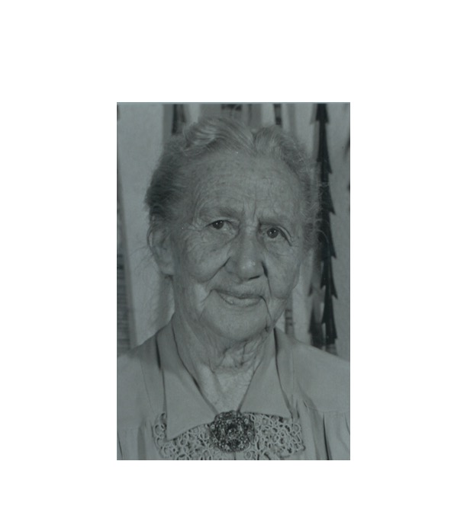
I WILL GO
REACH MY WORLD
Ana Stahl
Ana Cristina Carlson Stahl was born in Switzerland in 1870 and immigrated with her family to the United States at age sixteen.
Notes:
Ana Cristina Carlson Stahl was born in Switzerland in 1870 and immigrated with her family to the United States at age sixteen.
She married Fernando Stahl in 1892, and the following year, they read the book, The Great Controversy, by Ellen G. White, purchased from a missionary bookseller. He also gave them Bible studies. Through the bookseller’s influence, the Stahls began keeping the Sabbath and Fernando stopped smoking.
When Fernando was fired from his job, he and Ana realized they wanted to work in an environment with opportunity to introduce people to Jesus. The transformation of their own lives was reason enough to say to others, “Come, see the Savior of the world. He saved us, and He can save you.” They began to pray, asking God to help them fulfill their dream. They took a step of faith and enrolled in nursing school together.
In 1909 while working as nurses in Ohio, they heard Pastor Joseph W. Westphal, the president of the Church for South America, appealing to people to become missionaries to the continent. This was the answer to their prayer! They would go as evangelizing nurses, or perhaps nurse evangelists! The Stahls traveled by boat to Peru to share the gospel even though they didn’t know a single word of Spanish.

Slide 23
Even today, 110 years after they arrived in Peru, the Andes Range community sing songs about Ana and Fernando Stahl.
Many children are named Ana and Fernando in Peru and Bolivia.
Churches, schools, and missions are also named after Ana Stahl.
Books are written about Ana, keeping her story alive, inspiring women from generation to generation to go reach the world.
Notes:
Ana and her husband offered medical assistance and established schools and churches. They gave instructions for better agricultural and sanitation practices. They obtained government aid for the Indians. They mediated tribal conflicts and helped other missionaries and humanitarian workers. They carried out many other deeds during their work in South America. Tens of thousands of people were brought to Christ through their effort. Ana and her husband Fernando Stahl are still remembered by Adventists and non-Adventists alike for their effective ministry.
Even today, 110 years after they arrived in Peru, the Andes Range community sing songs about Ana and Fernando Stahl. Many children are named Ana and Fernando in Peru and Bolivia. Churches, schools, and missions are also named after Ana Stahl, such as Ana Stahl Clinic, in Iquitos, Peru, and the Stahl Center for World Missions, at La Sierra University in California. Books are written about Ana, keeping her story alive, inspiring women from generation to generation to go reach the world.

Slide 24
Many women make a difference every day at home in the lives of their families and churches.
They change neighborhoods, cities, regions, and even nations by their work and influence. When we invite others to come, see the Savior of the world, we make a difference.
Notes:
Many women make a difference every day at home in the lives of their families and churches. They change neighborhoods, cities, regions, and even nations by their work and influence. When we invite others to come, see the Savior of the world, we make a difference.

Slide 25

WE ARE CALLED TO GO
REACH OUR WORLD
Notes:
WE ARE CALLED TO GO REACH OUR WORLD
No matter who we are, we CAN invite others to come, see the Savior of the world. HOW we share Jesus with others is made effective by our own personal experience with Him.
You and I have received the call to go reach our world. Don’t let your imperfections, lack of knowledge or skills, or impossibilities stop you. Prioritize your mission, share your testimony, focus on Jesus, and be a living reminder of Jesus wherever you go! Without a doubt, when you do this, others will believe in Jesus because of your transformation!

Slide 26
Do you, women and men, desire to leave this sacred assembly today declaring the same words as the Samaritan woman? “Come, see a man who told me everything I ever did.”
Do you long to introduce your family, friends, and neighbors to Jesus because of what He’s done for you? Will your loved ones have opportunity to say, “Now we have heard for ourselves, and we know that this man really is the Savior of the world”?
Notes:
Do you, women and men, desire to leave this sacred assembly today declaring the same words as the Samaritan woman? “Come, see a man who told me everything I ever did” (v. 29).
Do you long to introduce your family, friends, and neighbors to Jesus because of what He’s done for you? Will your loved ones have opportunity to say, “Now we have heard for ourselves, and we know that this man really is the Savior of the world” (v. 42)?

Slide 27
LET US STAND AND PRAY THAT GOD GIVES US OPPORTUNITIES AND COURAGE TO RESPOND,
“HERE I AM. SEND ME.
I WILL GO REACH MY WORLD.”
Notes:
Let us stand and pray that God gives us opportunities and courage to respond,
“Here I am. Send Me. I will go reach my world.”

