Slide 1
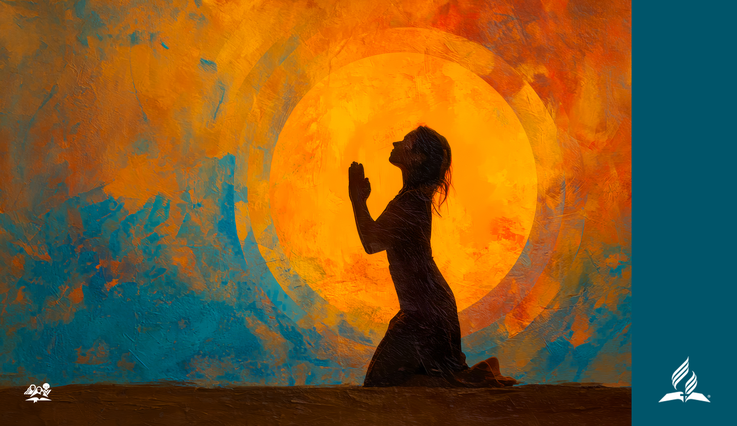
A WOMAN,
faith, and prayer
Written by Ardis Dick Stenbakken
INTERNATIONAL WOMEN’S DAY OF PRAYER 2026

Slide 2

Hebrews 4:14–16, NIV
Therefore, since we have a great high priest who has ascended into heaven, Jesus the Son of God, let us hold firmly to the faith we profess. For we do not have a high priest who is unable to empathize with our weaknesses, but we have one who has been tempted in every way, just as we are—yet he did not sin. Let us then approach God’s throne of grace with confidence, so that we may receive mercy and find grace to help us in our time of need.

Slide 3

A woman came to Jesus.
First, in Matthew 15, Matthew says she was a Canaanite—Gentile, a heathen! (see verse 22). Someone with whom the Jews did not want to associate. Mark says further that she was a Greek, born in Syrian Phoenicia (see Mark 7:26).
Second, a woman was not supposed to approach a man other than her husband.

Slide 4

In Matthew 15:22 she says,
“Lord, Son of David, have mercy on me! My daughter is demon-possessed and suffering terribly.”

Slide 5
Matthew says,
“Jesus did not answer a word” (verse 23).
Have you ever felt ignored, unheard by God? Sometimes it is hard to maintain faith when we feel our prayers are not heard.

Slide 6
In a concentration camp, during World War II, a Jewish prisoner wrote,
“I believe in the sun
Even when it is not shining
And I believe in love,
Even when there’s no one there.
And I believe in God,
Even when He is silent.”

Slide 7
In verse 24, Jesus answers:
“I was sent only to the lost sheep of Israel.”
That is like saying:
“I was sent only for Christians, not Muslims.”
“I was sent only for white people, not people of color.”
“I was sent only for rich people, not poor people.”
“I was sent only for the highly educated, not the rest of you.”
This is so unlike Jesus!

Slide 8
To Understand Jesus’ Reaction:
By ministering to her sorrow, He could give a living representation of the lesson He designed to teach. . . . The [Jewish] people who had been given every opportunity to understand the truth were without a knowledge of the needs of those around them. No effort was made to help souls in darkness. The partition wall which Jewish pride had erected shut even the disciples from sympathy with the heathen world. But these barriers were to be broken down.
—Ellen G. White, Daughters of God, 65

Slide 9
Can you even imagine that,
Jesus went all that way from Galilee to meet this one woman? He valued that woman. He valued her daughter. He valued her petition, her prayer, and He was ready and willing to answer. Scripture indicates that He did not do another thing there in Tyre, no other miracle or act or teaching there.

Slide 10
Faith still cries out,
“Lord, help me!” (Matthew 15:25).
In verse 26, Jesus said, “It is not right to take the children’s bread and toss it to the dogs.”
Faith never gives up.
In verse 27, she held on. She did not ignore the statement about dogs. Instead, she agreed. “ ‘Yes it is, Lord,’ she said. ‘Even the dogs eat the crumbs that fall from their master’s table.’ ”

Slide 11
Even Jesus’ crumbs can meet all our needs.
Just think about that. We are coming to the I AM, the omnipotent Ruler of the universe. Nothing is too hard for Him, nothing.
We just need to ask in faith.

Slide 12
Finally, in verse 28, Jesus responded:
“Woman, you have great faith! Your request is granted” (Matthew 15:28).
True faith triumphs! It is almost as if the Lord of glory surrendered to the conquering arms of a woman’s faith and her prayer.

Slide 13
Just like the faith of the centurion
“ ‘Assuredly, I say to you, I have not found such great faith, not even in Israel! And I say to you that many will come from east and west, and sit down with Abraham, Isaac, and Jacob in the kingdom of heaven. . . .’ Then Jesus said to the centurion, ‘Go your way; and as you have believed, so let it be done for you.’ And his servant was healed that same hour” (Matthew 8:10, 11, 13, NKJV).

Slide 14
Lessons from the Story:
One, of course, is faith, faith that we have noted all through the story of her request and responses. Faith that hangs on even when there is no immediate response.
Second is persistence. She did not let anything stop her, not the disciples, not the silence, not what could have been taken as a rude put-down. Not culture, not those around her. She had a mission, and she was not going to let anything stand in the way of her prayer for help.

Slide 15
Lessons from the Story:
Third: There was also a lesson for the disciples and for us: We present a prayer on behalf of someone else. We may have faith and persistence. But do we really believe that God, that Jesus, cares about them? Do we even act like we really care about people?

Slide 16
In Conclusion,
This Canaanite, this Gentile, a Greek woman born in Syrian Phoenicia shows us how to pray, how to ask for mercy, not telling God how to answer—but asking for mercy and persisting in faith. She had a prayer of faith that refused to be silent, that called out, “Have mercy!” A faith that never gives up, despite obstacles.

Slide 17
Hebrews 4:16
“Let us then approach God’s throne of grace with confidence, so that we may receive mercy and find grace to help us in our time of need.”

