Slide 1
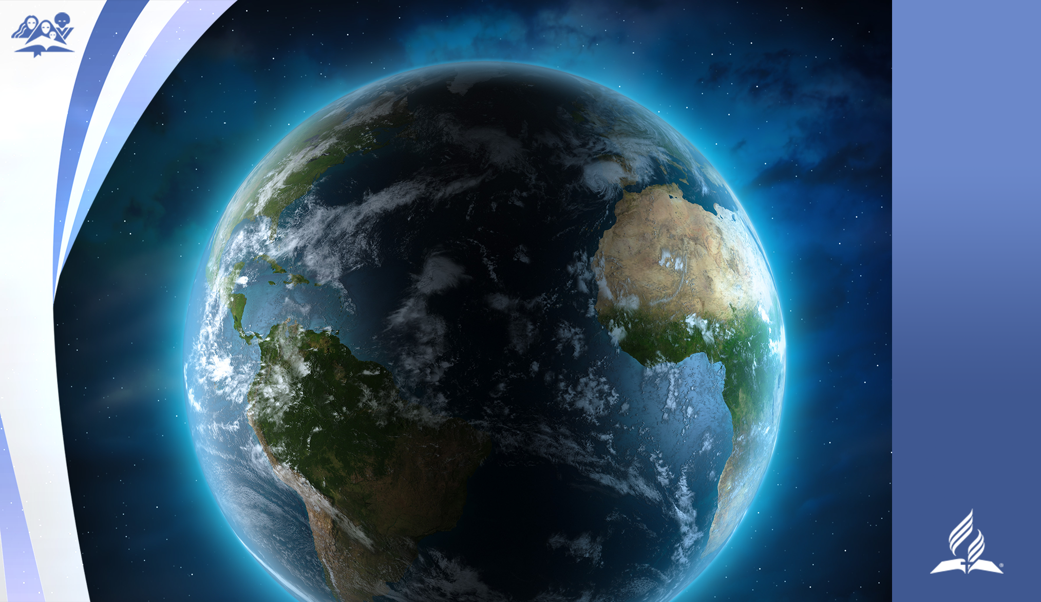
CREATION WEEK

Slide 2


Slide 3

DAY 1

Slide 4

DAY 2

Slide 5

DAY 3

Slide 6
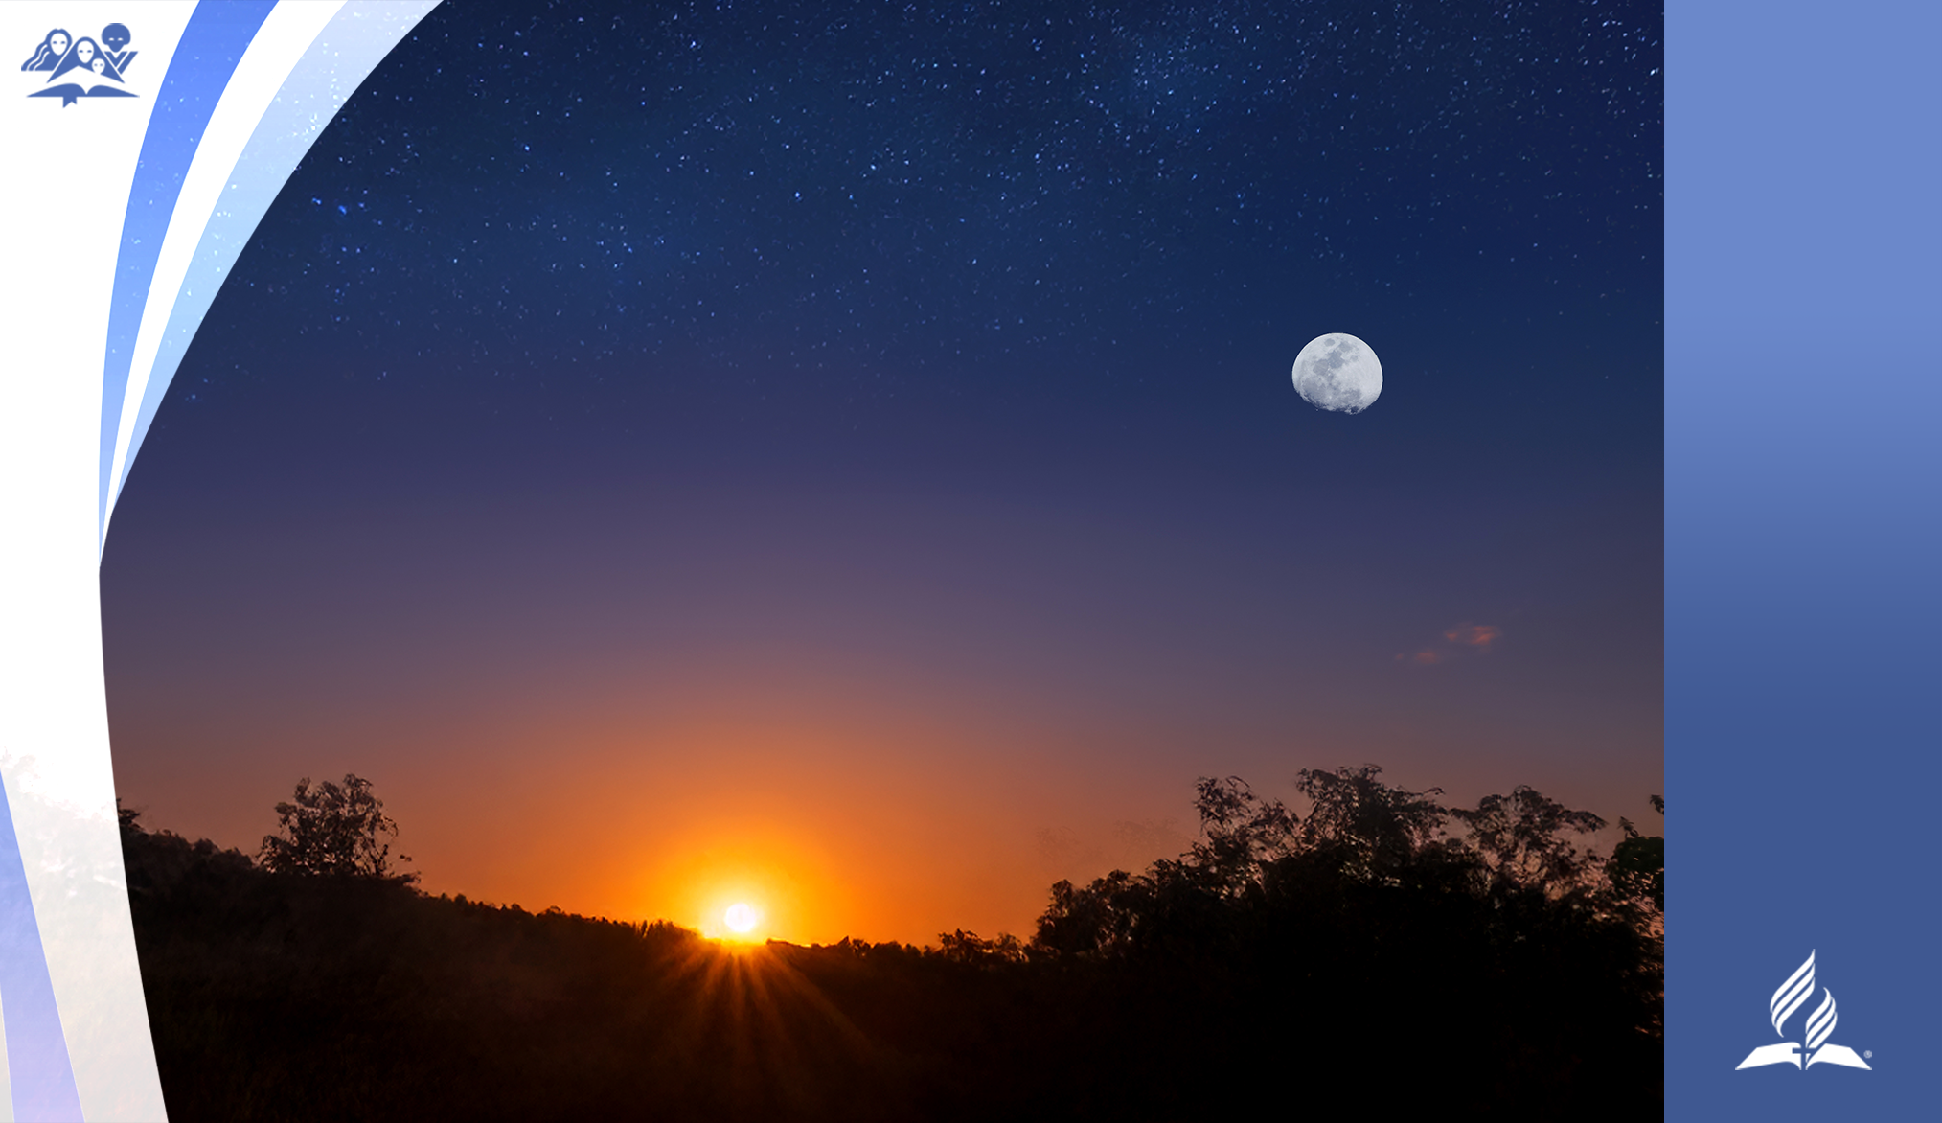
DAY 4

Slide 7

DAY 5

Slide 8
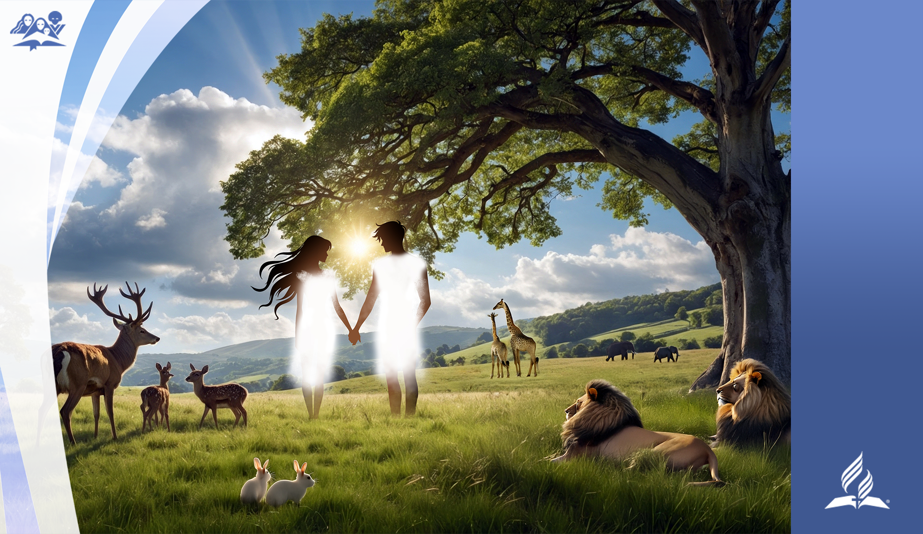
DAY 6

Slide 9
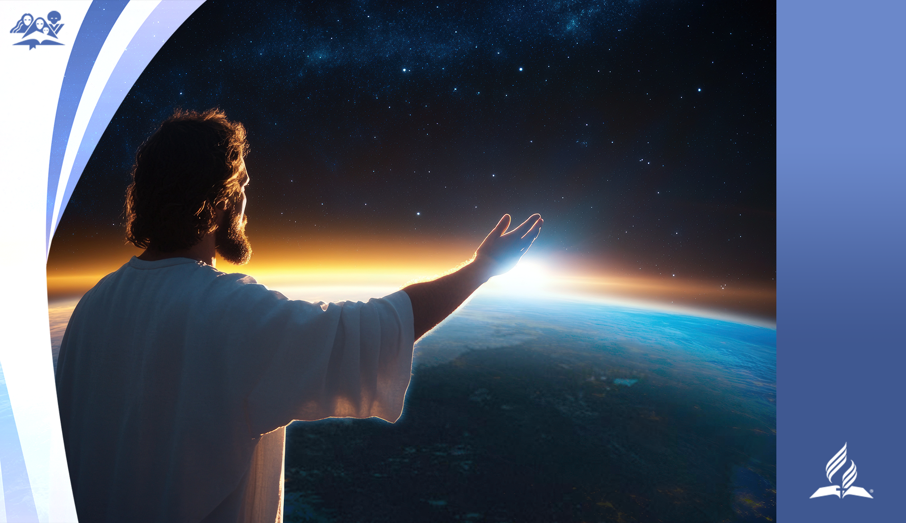
DAY 7

