Slide 2
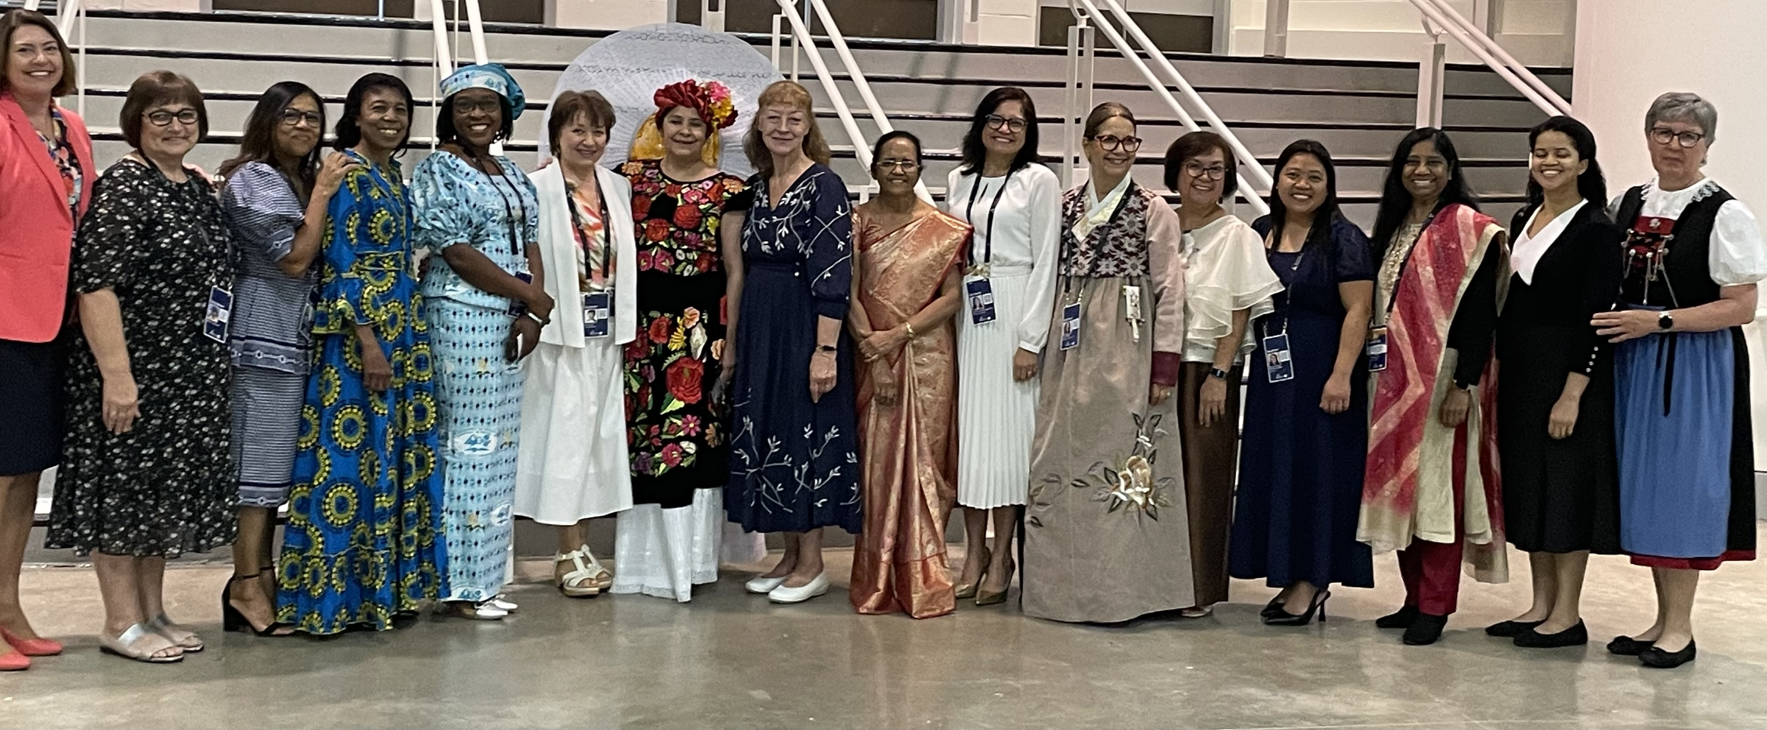
WOMEN’S MINISTRIES DEPARTMENT

Slide 3

WOMEN’S MINISTRIES DEPARTMENT
1898
1980
1985
1988
1989
1990
1995

Slide 4
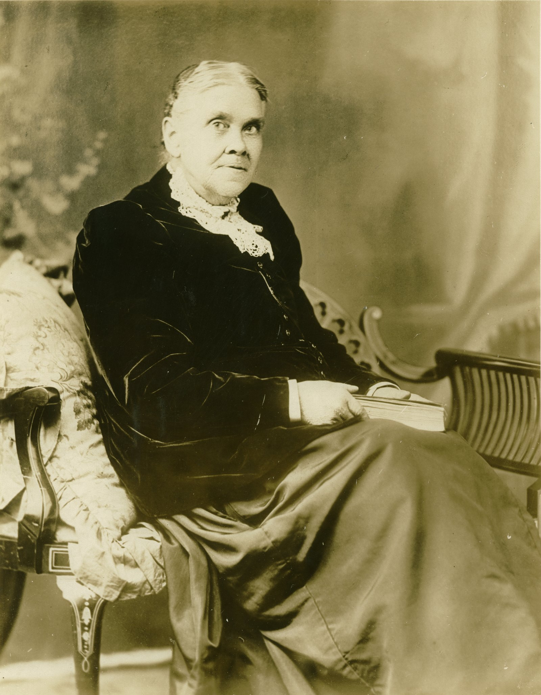
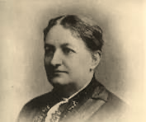
Ellen G. White
“There certainly should be a larger number of women engaged in the work of ministering to suffering humanity, uplifting, educating them how to believe—simply believe—in Jesus Christ our Savior.”
(Ellen G. White, Welfare Ministry, 143.1)
Sarepta M. I. Henry

Slide 5
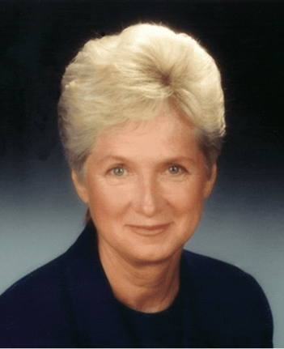
WM Department Directors 1995-2025
Rose Otis
1995-1996

Slide 6
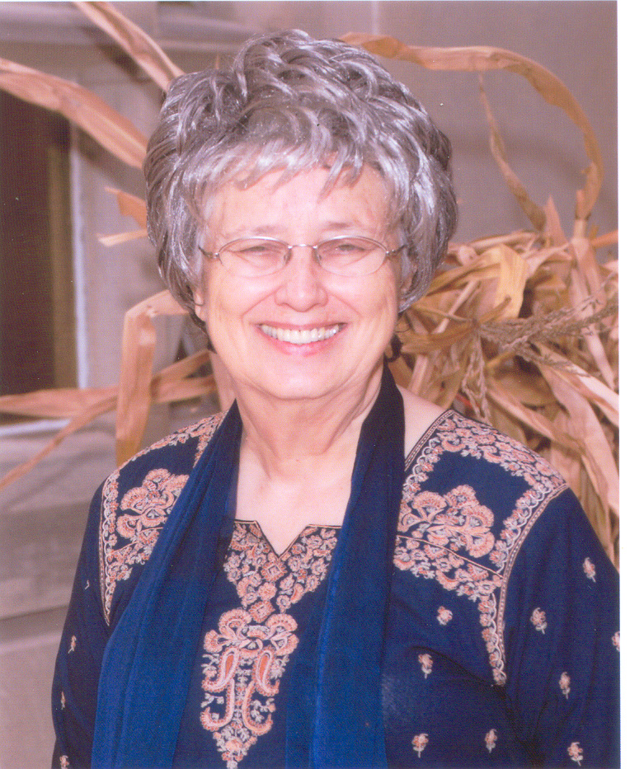
WM Department Directors 1995-2025
Dorothy Watts
1996-1997

Slide 7
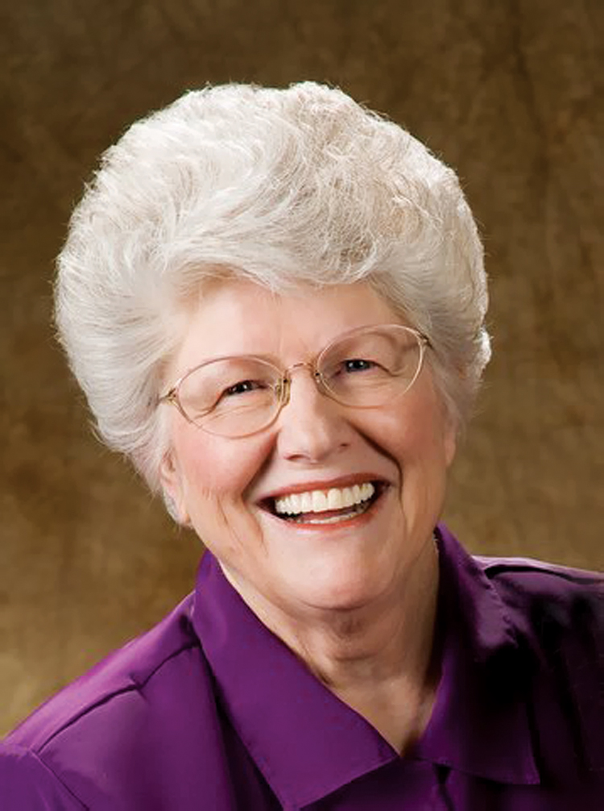
WM Department Directors 1995-2025
Ardis Stenbakken
1997-2004

Slide 8
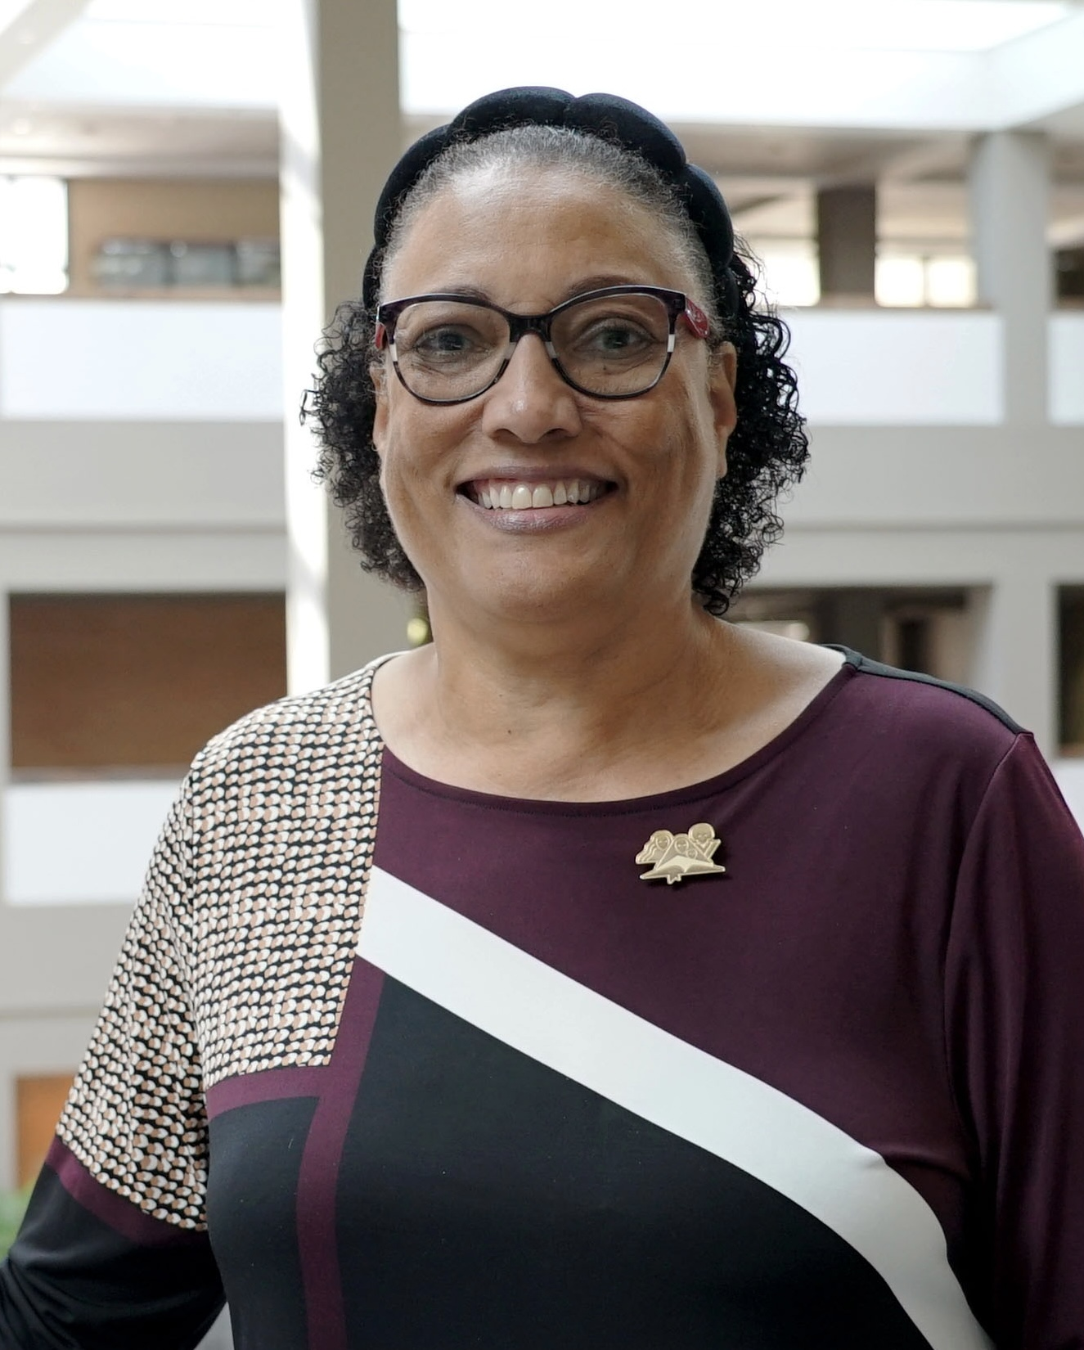
WM Department Directors 1995-2025
Heather-Dawn Small
2005-2024

Slide 9
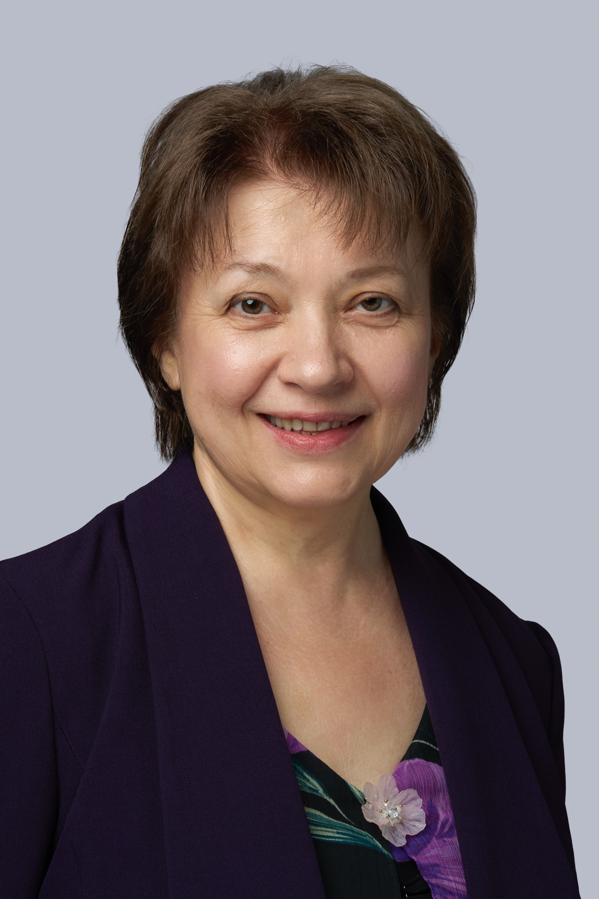
WM Department Directors 1995-2025
Galina Stele
2024-Present

Slide 10
Mission Statement:
The Department of Women’s Ministries exists to uphold, encourage, and challenge Adventist women in their pilgrimage as disciples of Jesus Christ and members of His world Church.

Slide 11

NURTURE
Grounded in the Bible
EMPOWER
Integrated
OUTREACH
Focused on the Mission

Slide 12
Globally, from 1996 to 2024:
3,509,687 people were baptized and
1,301,703 people were reclaimed into the Adventist
Church
because of the direct efforts of Adventist women and Women’s Ministries activities.

Slide 13



